Slide 1
Handbook of Markov Chain Monte Carlo (Chap. 1&5)
Chang Liu
2014-11-17

Slide 2
Outline
Chapter 1: Introduction to MCMC
Chapter 5: MCMC using Hamiltonian dynamics

Slide 3
Introduction to Markov Chain Monte Carlo Charles J. Geyer
History
Markov Chains
Intuitions of MCMC
Elementary Theory of MCMC
The Metropolis-Hastings-Green Algorithm

Slide 4
Introduction to MCMC
Brief history
The invention of computer stimulates simulation methods.
Metropolis et al.(1953) simulated a liquid in equilibrium with its gas phase by a Markov chain.
Hastings (1970) generalized the Metropolis algorithm, and simulations following his scheme are said to use the Metropolis-Hastings algorithm.
A special case of the Metropolis-Hastings algorithm was introduced by Geman and Geman (1984). Simulations following their scheme are said to use the Gibbs sampler.
Green (1995) generalized the Metropolis–Hastings algorithm: Metropolis–Hastings–Green algorithm.

Slide 5
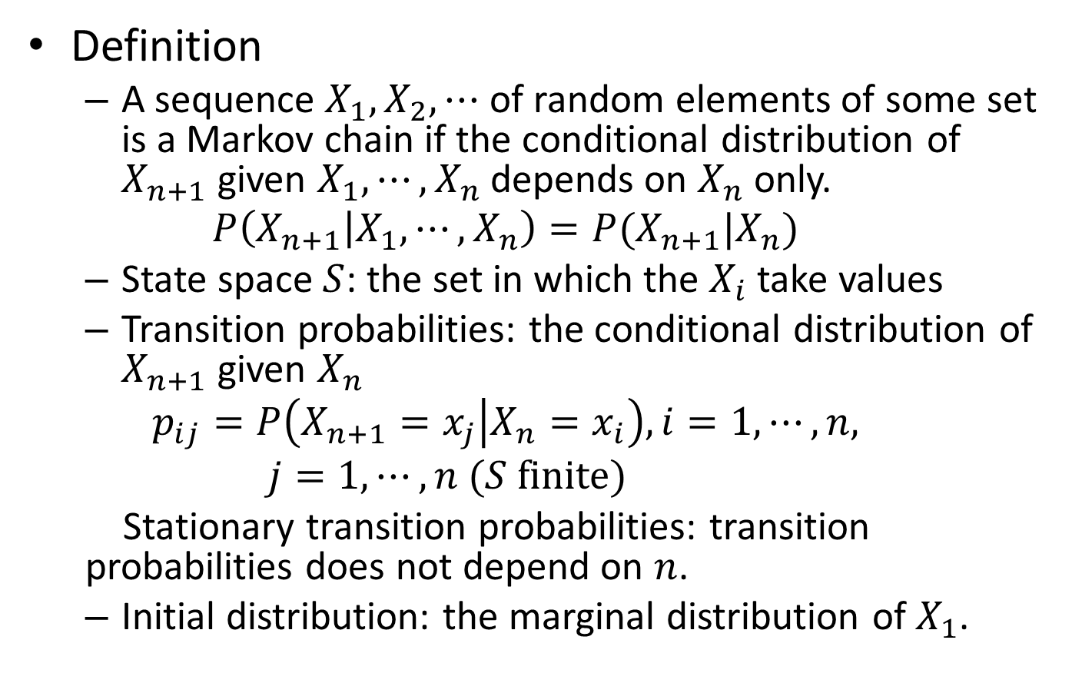
Markov Chains
Definition
A sequence $X_{1}, X_{2},⋯$ of random elements of some set is a Markov chain if the conditional distribution of $X_{n+1}$ given $X_{1}, ⋯,X_{n}$ depends on $X_{n}$ only.
$$P\left(X_{n+1} | X_{1},⋯,X_{n}\right)=P(X_{n+1}|X_{n})$$
State space $S$: the set in which the $X_{i}$ take values
Transition probabilities: the conditional distribution of $X_{n+1}$ given $X_{n}$
$$p_{ij}=P\left(X_{n+1}=x_{j} | X_{n}=x_{i}\right), i=1,⋯,n, j=1,⋯,n (S finite)$$
Stationary transition probabilities: transition probabilities does not depend on $n$.
Initial distribution: the marginal distribution of $X_{1}$.

Slide 6
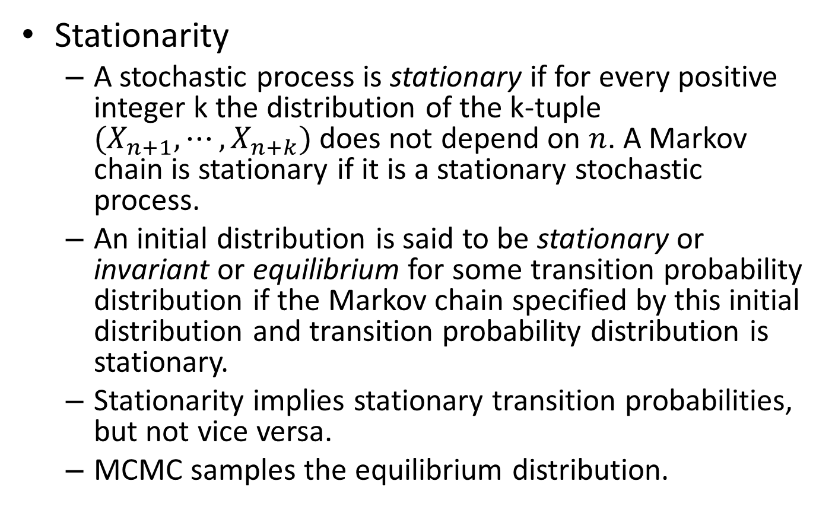
Markov Chains
Stationarity
A stochastic process is stationary if for every positive integer k the distribution of the k-tuple $(X_{n+1},⋯,X_{n+k})$ does not depend on $n$. A Markov chain is stationary if it is a stationary stochastic process.
An initial distribution is said to be stationary or invariant or equilibrium for some transition probability distribution if the Markov chain specified by this initial distribution and transition probability distribution is stationary.
Stationarity implies stationary transition probabilities, but not vice versa.
MCMC samples the equilibrium distribution.

Slide 7
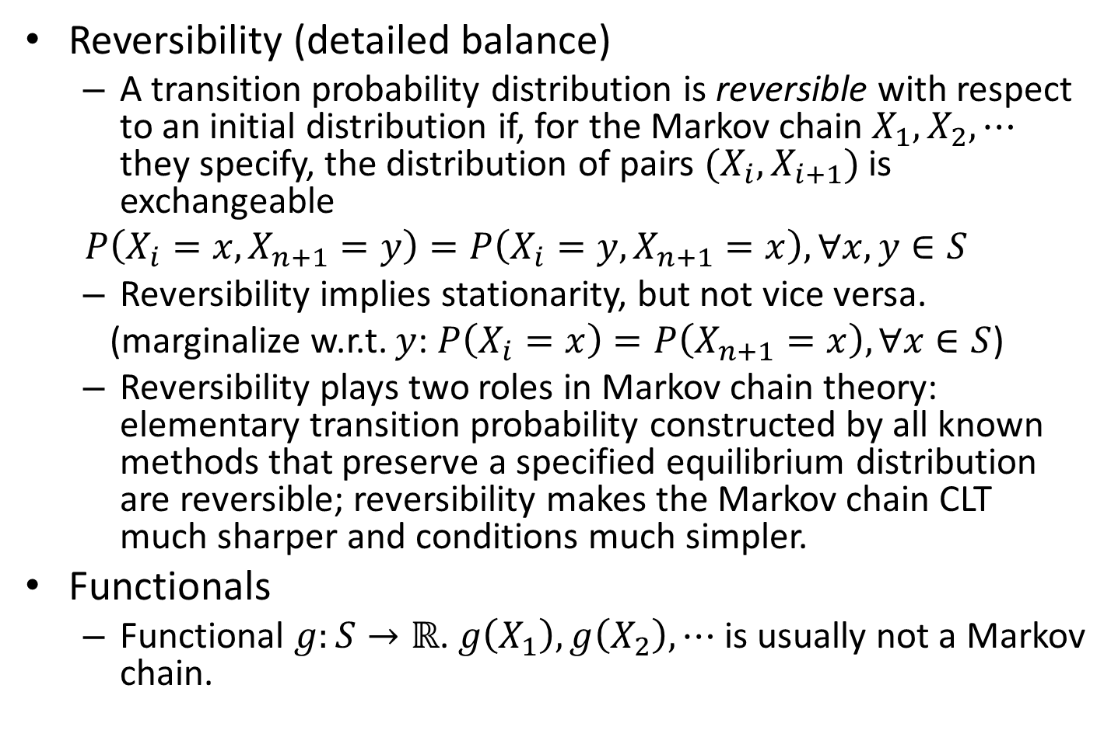
Markov Chains
Reversibility (detailed balance)
A transition probability distribution is reversible with respect to an initial distribution if, for the Markov chain $X_{1},X_{2},⋯$ they specify, the distribution of pairs $(X_{i},X_{i+1})$ is exchangeable
$$P\left(X_{i}=x,X_{n+1}=y\right)=P\left(X_{i}=y,X_{n+1}=x\right), ∀x,y∈S$$
Reversibility implies stationarity, but not vice versa.
(marginalize w.r.t. $y$: $P\left(X_{i}=x\right)=P\left(X_{n+1}=x\right), ∀x∈S$)
Reversibility plays two roles in Markov chain theory: elementary transition probability constructed by all known methods that preserve a specified equilibrium distribution are reversible; reversibility makes the Markov chain CLT much sharper and conditions much simpler.
Functionals
Functional $g:S→ℝ$. $g\left(X_{1}\right),g\left(X_{2}\right),⋯$ is usually not a Markov chain.

Slide 8



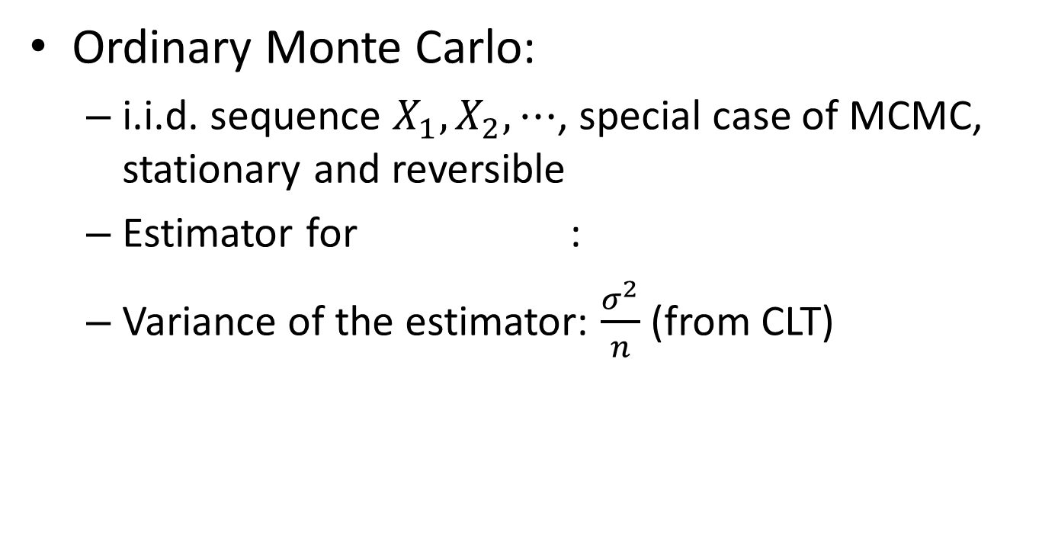
Intuitions of MCMC
Ordinary Monte Carlo:
i.i.d. sequence $X_{1},X_{2},⋯$, special case of MCMC, stationary and reversible
Estimator for :
Variance of the estimator: $\frac{σ^{2}}{n}$ (from CLT)

Slide 9


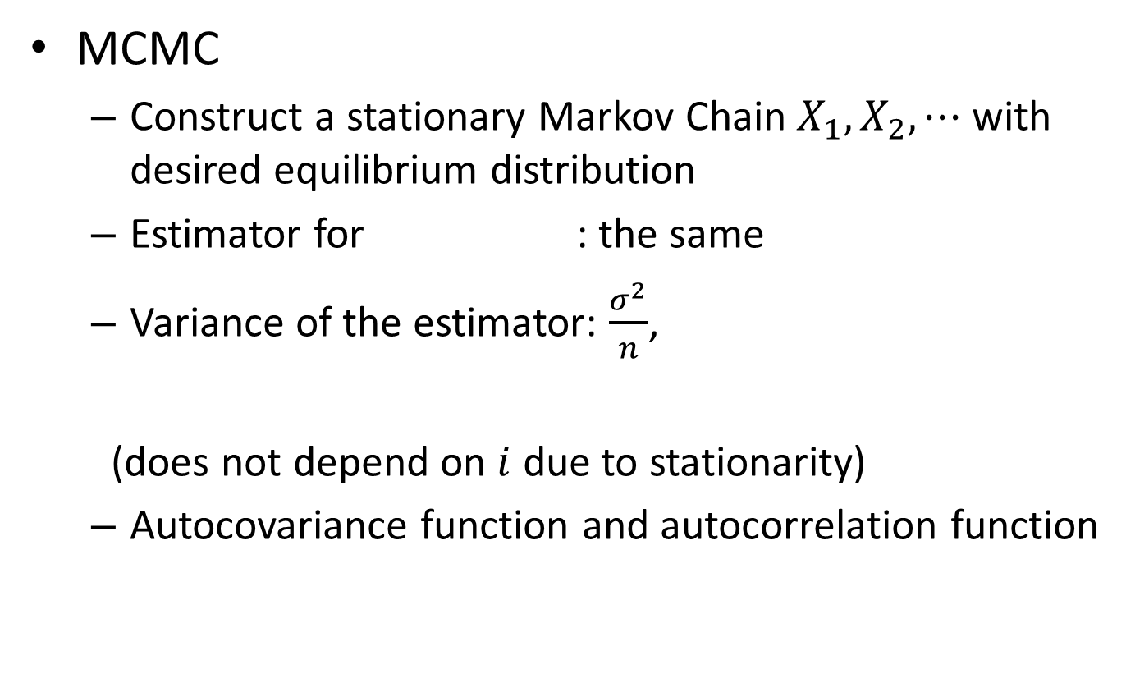
Intuitions of MCMC
MCMC
Construct a stationary Markov Chain $X_{1},X_{2},⋯$ with desired equilibrium distribution
Estimator for : the same
Variance of the estimator: $\frac{σ^{2}}{n}$,
(does not depend on $i$ due to stationarity)
Autocovariance function and autocorrelation function

Slide 10








Intuitions of MCMC
AR(1) Example
Autoregressive:
Stationarity requires
i.e. , so $ρ^{2}<1$
Estimate $EX$: ${\hat{μ}}_{n}=\frac{1}{n}\sum_{i=1}^{n}{X_{i}}$, ${\hat{μ}}_{n}∼𝒩\left(μ,\frac{σ^{2}}{n}\right)$

Slide 11
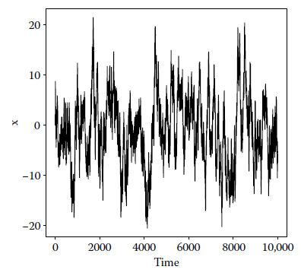
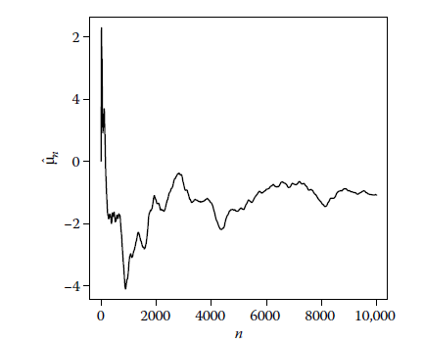
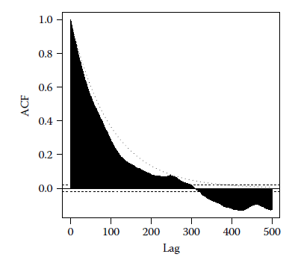
Intuitions of MCMC
AR(1) example
Simulation results (stationarity, CLT, autocorrelation)

Slide 12


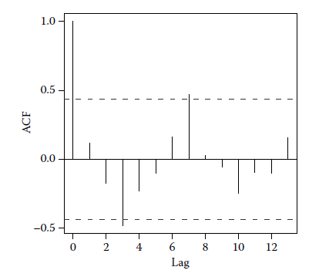

Intuitions of MCMC
Variance Estimation
Nonoverlapping Batch Means
$m$ nonoverlapping batches with each length of $b$
$∼𝒩\left(μ,\frac{σ^{2}}{b}\right)$,
$\frac{{\hat{σ}}^{2}}{b}=$
${\hat{μ}}_{b,k}$ and ${\hat{μ}}_{b,k+1}$ are not
significantly correlated

Slide 13



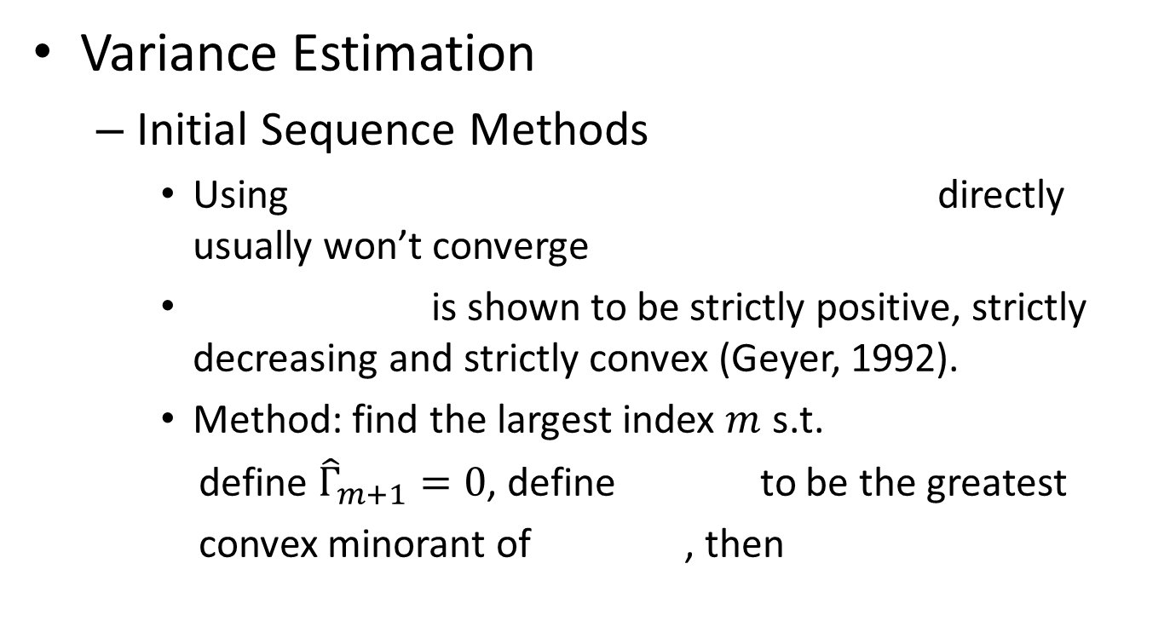
Intuitions of MCMC
Variance Estimation
Initial Sequence Methods
Using directly usually won’t converge
is shown to be strictly positive, strictly decreasing and strictly convex (Geyer, 1992).
Method: find the largest index $m$ s.t.
define ${\hat{Γ}}_{m+1}=0$, define to be the greatest
convex minorant of , then

Slide 14
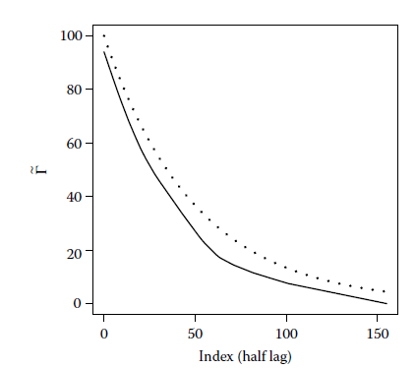
Intuitions of MCMC
Variance Estimation
Initial Sequence Methods

Slide 15
Intuitions of MCMC
The Practice of MCMC
Black Box MCMC (nothing is known except the outputs)
Pseudo-Convergence
The chain appears to converge when it has not. The parts of the state space are poorly connected. “multimodality”
One Long Run vs. Many Short Runs (to avoid pseudo- convergence)
Burn-in
(comes from electronics) throwing away some iterations at the beginning of an MCMC run.

Slide 16
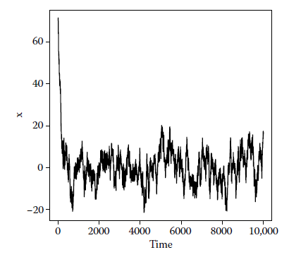
Intuitions of MCMC
The Practice of MCMC
Burn-in
start the next run where
the last run ended
All decisions about starting
points are based on the output
of some preliminary runs that
appear to have “converged”.
Unnecessary
Diagnostics
Perfect sampling, guaranteed to produce an i.i.d. sample from the equilibrium distribution of the Markov chain
Does not work on black box MCMC

Slide 17


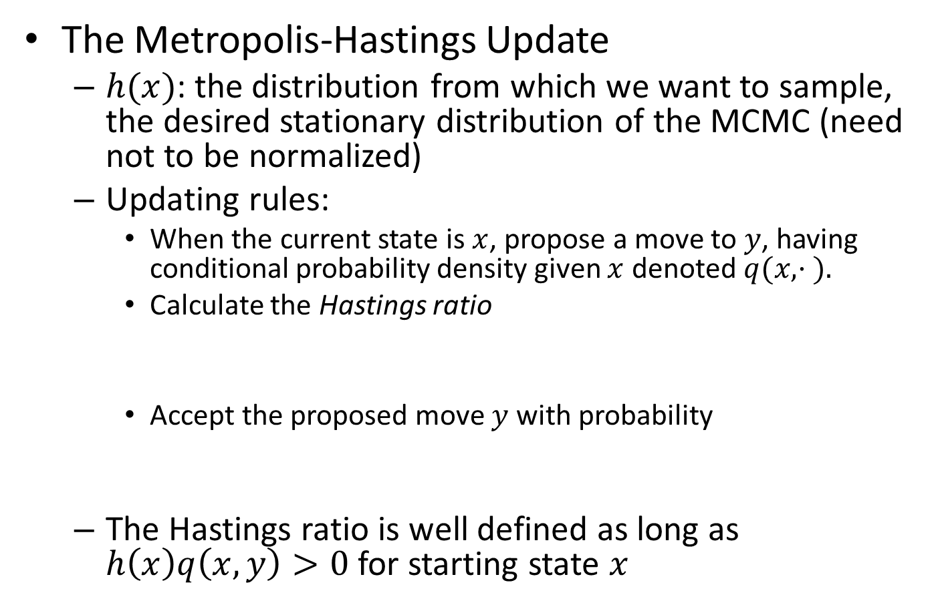
Elementary Theory of MCMC
The Metropolis-Hastings Update
$h(x)$: the distribution from which we want to sample, the desired stationary distribution of the MCMC (need not to be normalized)
Updating rules:
When the current state is $x$, propose a move to $y$, having conditional probability density given $x$ denoted $q(x, · ).$
Calculate the Hastings ratio
Accept the proposed move $y$ with probability
The Hastings ratio is well defined as long as $h\left(x\right)q\left(x,y\right)>0$ for starting state $x$

Slide 18

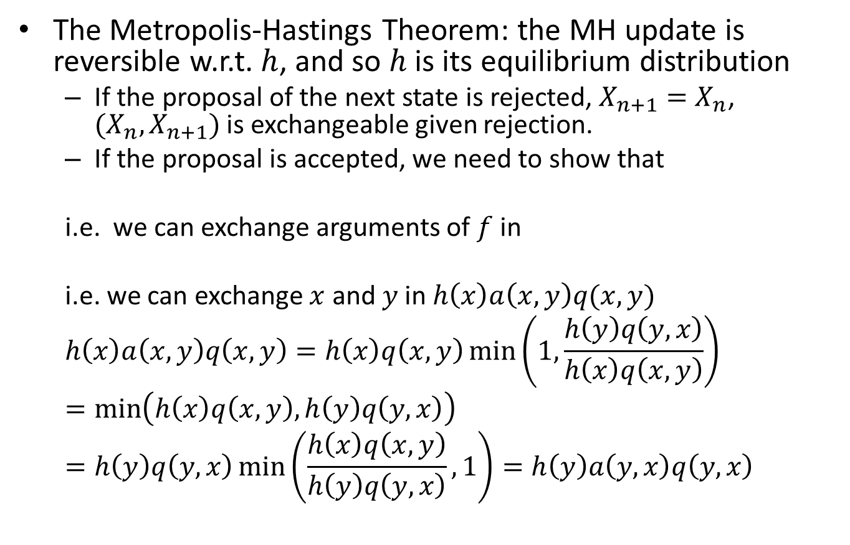
Elementary Theory of MCMC
The Metropolis-Hastings Theorem: the MH update is reversible w.r.t. $h$, and so $h$ is its equilibrium distribution
If the proposal of the next state is rejected, $X_{n+1}=X_{n}$, $(X_{n},X_{n+1})$ is exchangeable given rejection.
If the proposal is accepted, we need to show that
i.e. we can exchange arguments of $f$ in
i.e. we can exchange $x$ and $y$ in $h\left(x\right)a\left(x,y\right)q(x,y)$
$$h\left(x\right)a\left(x,y\right)q\left(x,y\right)=h\left(x\right)q\left(x,y\right)\min\left(1,\frac{h\left(y\right)q\left(y,x\right)}{h\left(x\right)q\left(x,y\right)}\right)=\min\left(h\left(x\right)q\left(x,y\right),h\left(y\right)q\left(y,x\right)\right)=h\left(y\right)q\left(y,x\right)\min\left(\frac{h\left(x\right)q\left(x,y\right)}{h\left(y\right)q\left(y,x\right)},1\right)=h\left(y\right)a\left(y,x\right)q\left(y,x\right)$$

Slide 19

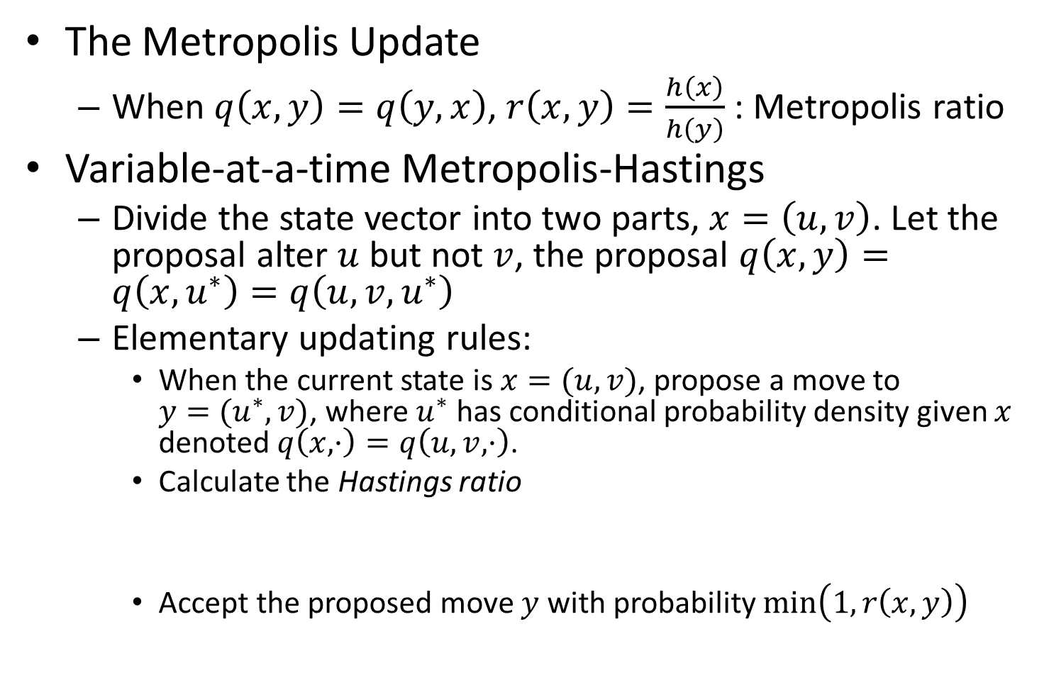
Elementary Theory of MCMC
The Metropolis Update
When $q\left(x,y\right)=q\left(y,x\right)$, $r\left(x,y\right)=\frac{h\left(x\right)}{h\left(y\right)}$ : Metropolis ratio
Variable-at-a-time Metropolis-Hastings
Divide the state vector into two parts, $x=\left(u,v\right)$. Let the proposal alter $u$ but not $v$, the proposal $q\left(x,y\right)=q\left(x,u^{∗}\right)=q\left(u,v,u^{∗}\right)$
Elementary updating rules:
When the current state is $x=(u,v)$, propose a move to $y=(u^{∗},v)$, where $u^{∗}$ has conditional probability density given $x$ denoted $q\left(x, ·\right)=q\left(u,v, ·\right)$.
Calculate the Hastings ratio
Accept the proposed move $y$ with probability $\min\left(1,r\left(x,y\right)\right)$

Slide 20
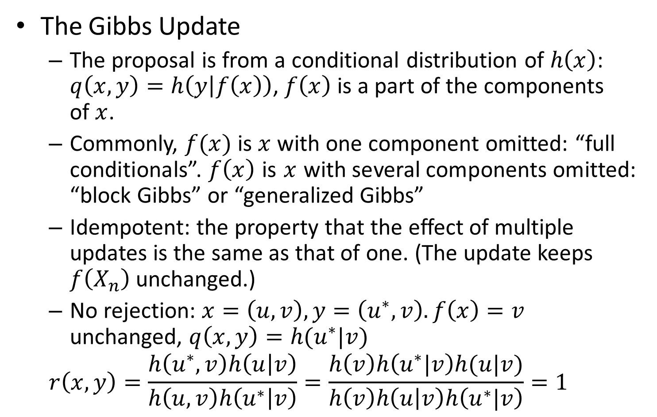
Elementary Theory of MCMC
The Gibbs Update
The proposal is from a conditional distribution of $h\left(x\right)$: $q\left(x,y\right)=h\left(y | f\left(x\right)\right)$, $f\left(x\right)$ is a part of the components of $x$.
Commonly, $f(x)$ is $x$ with one component omitted: “full conditionals”. $f\left(x\right)$ is $x$ with several components omitted: “block Gibbs” or “generalized Gibbs”
Idempotent: the property that the effect of multiple updates is the same as that of one. (The update keeps $f\left(X_{n}\right)$ unchanged.)
No rejection: $x=\left(u,v\right), y=\left(u^{∗},v\right). f\left(x\right)=v$ unchanged, $q\left(x,y\right)=h(u^{∗}|v)$
$$r\left(x,y\right)=\frac{h\left(u^{∗},v\right)h\left(u | v\right)}{h\left(u,v\right)h\left(u^{∗} | v\right)}=\frac{h\left(v\right)h\left(u^{∗}|v\right)h(u|v)}{h\left(v\right)h\left(u | v\right)h\left(u^{∗}|v\right)}=1$$

Slide 21
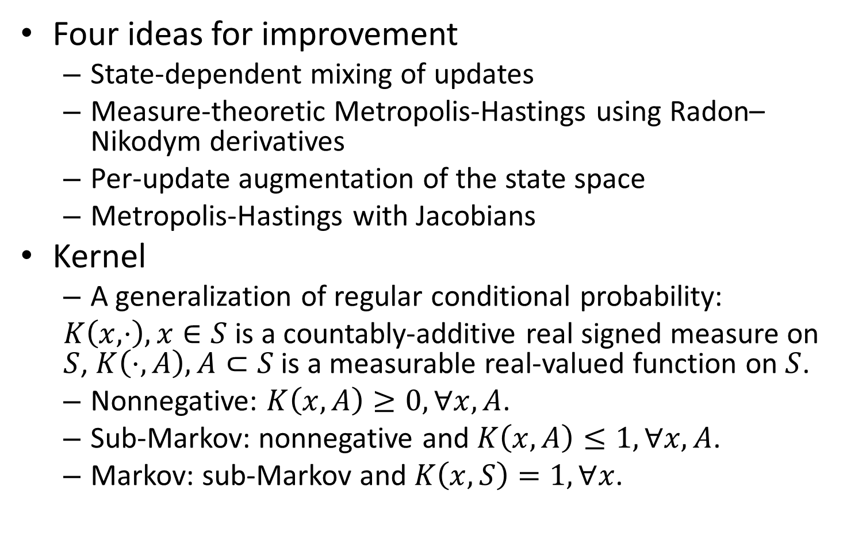
The Metropolis-Hastings-Green Algorithm
Four ideas for improvement
State-dependent mixing of updates
Measure-theoretic Metropolis-Hastings using Radon–Nikodym derivatives
Per-update augmentation of the state space
Metropolis-Hastings with Jacobians
Kernel
A generalization of regular conditional probability:
$K\left(x,⋅\right),x∈S$ is a countably-additive real signed measure on $S$, $K\left(⋅,A\right),A⊂S$ is a measurable real-valued function on $S$.
Nonnegative: $K\left(x,A\right)≥0,∀x,A$.
Sub-Markov: nonnegative and $K\left(x,A\right)≤1,∀x,A$.
Markov: sub-Markov and $K\left(x,S\right)=1, ∀x$.

Slide 22


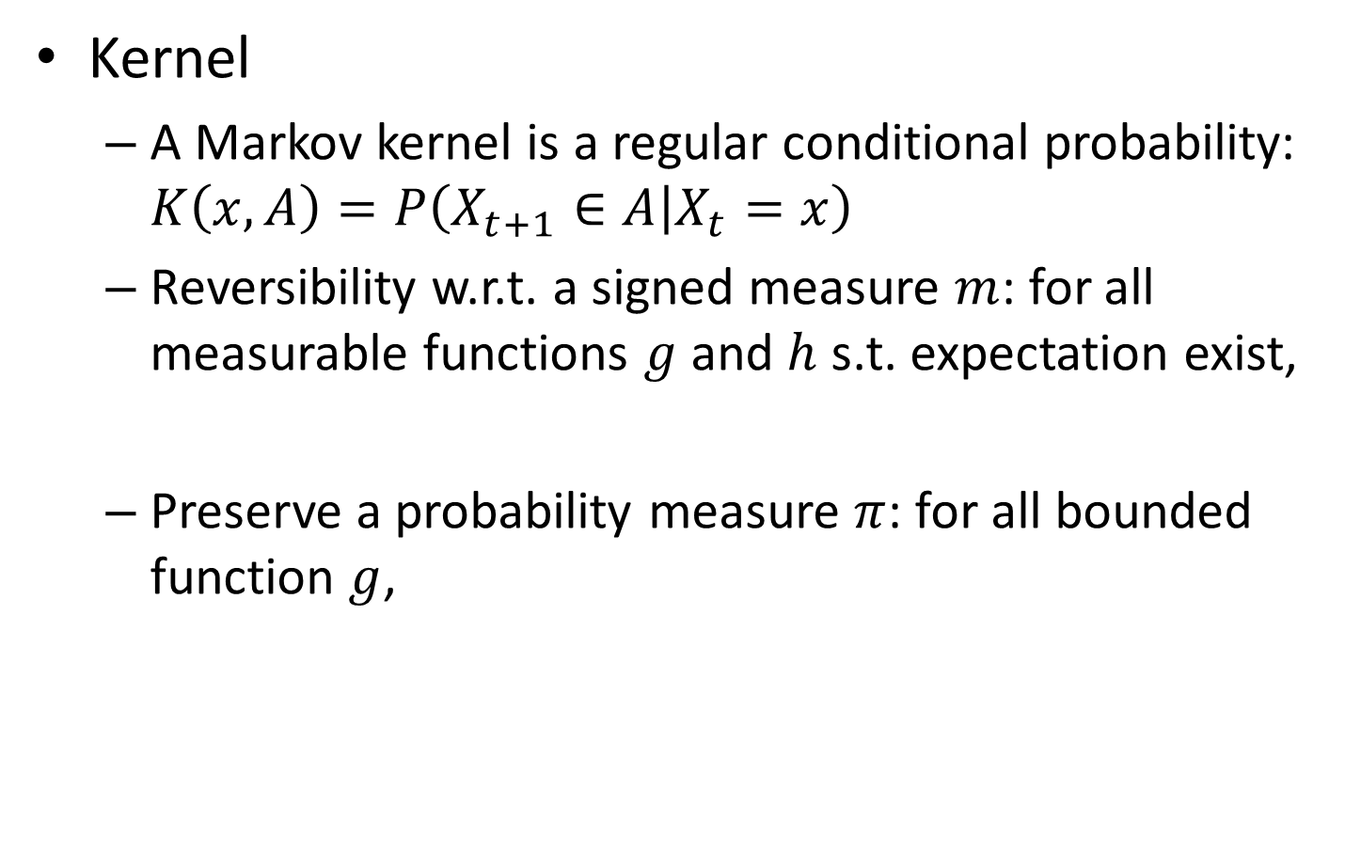
The Metropolis-Hastings-Green Algorithm
Kernel
A Markov kernel is a regular conditional probability: $K\left(x,A\right)=P\left(X_{t+1}∈A | X_{t}=x\right)$
Reversibility w.r.t. a signed measure $m$: for all measurable functions $g$ and $h$ s.t. expectation exist,
Preserve a probability measure $π$: for all bounded function $g$,

Slide 23


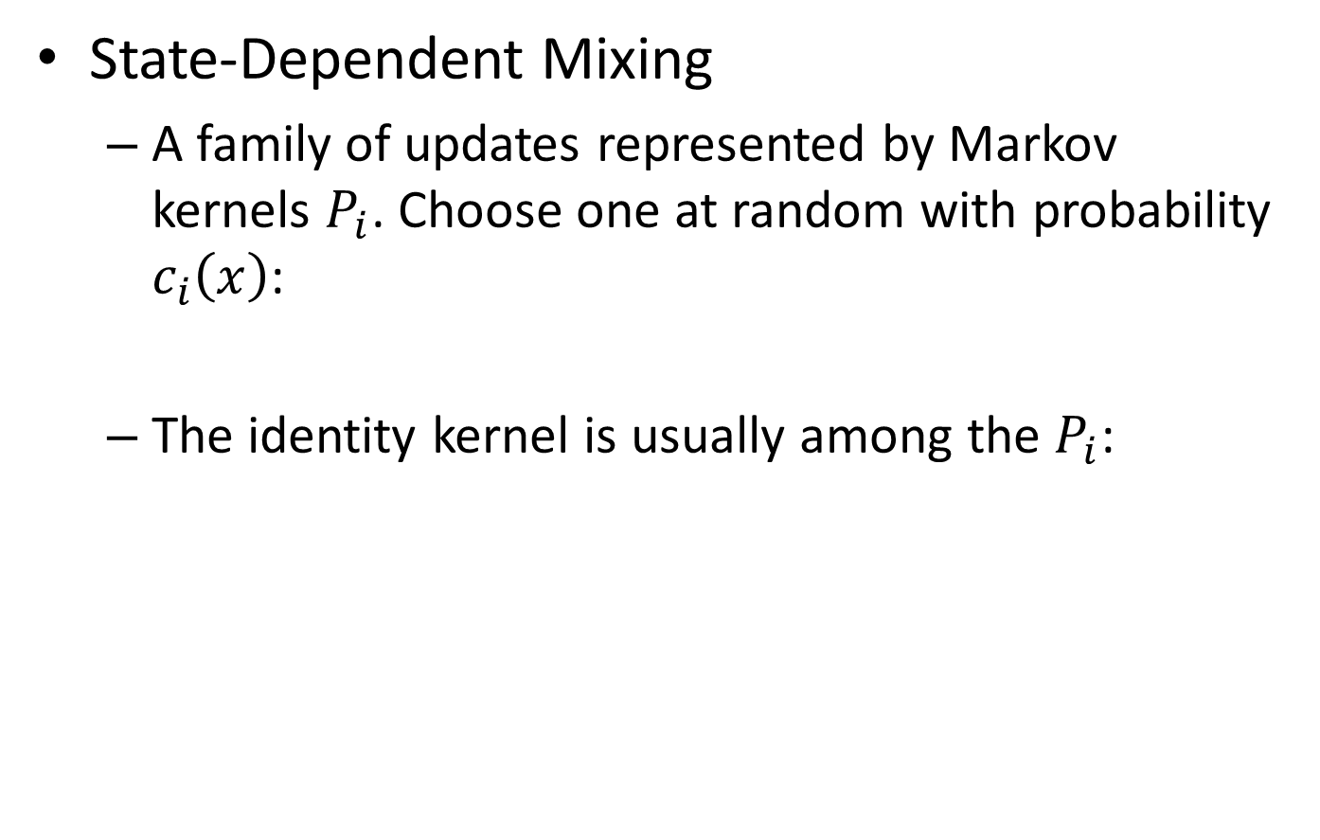
The Metropolis-Hastings-Green Algorithm
State-Dependent Mixing
A family of updates represented by Markov kernels $P_{i}$. Choose one at random with probability $c_{i}\left(x\right)$:
The identity kernel is usually among the $P_{i}$:

Slide 24
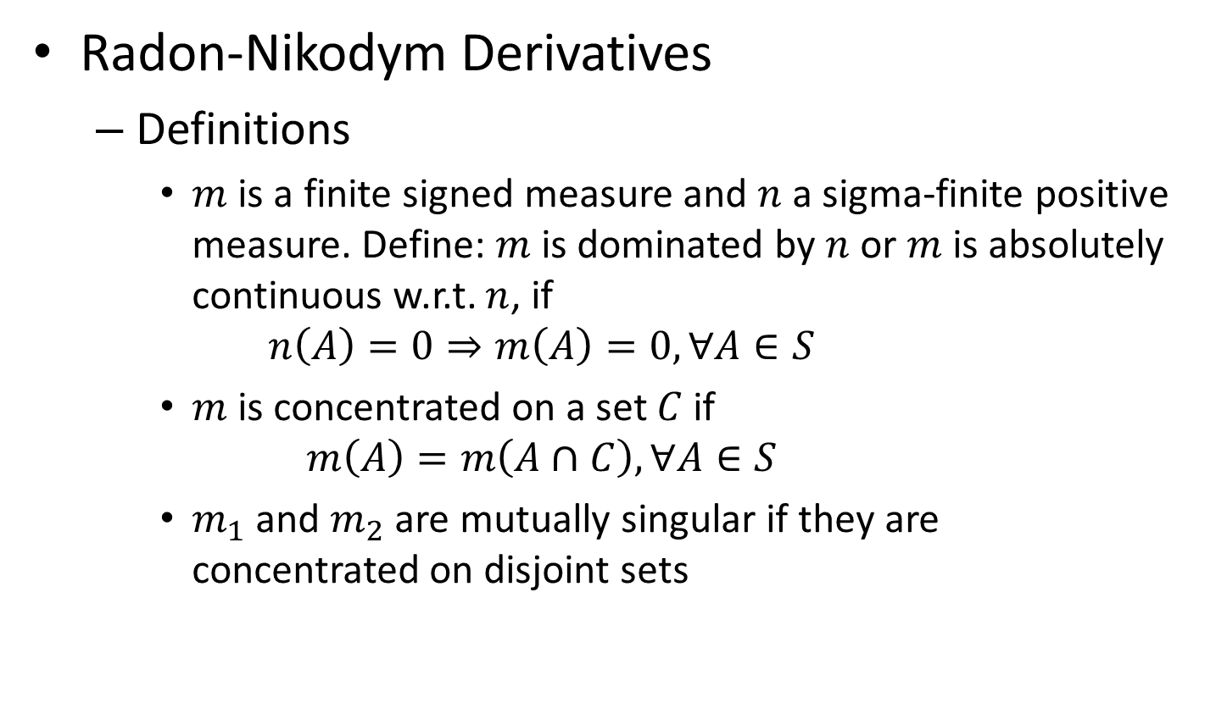
The Metropolis-Hastings-Green Algorithm
Radon-Nikodym Derivatives
Definitions
$m$ is a finite signed measure and $n$ a sigma-finite positive measure. Define: $m$ is dominated by $n$ or $m$ is absolutely continuous w.r.t. $n$, if
$$n\left(A\right)=0⇒m\left(A\right)=0, ∀A∈S$$
$m$ is concentrated on a set $C$ if
$$m\left(A\right)=m\left(A∩C\right), ∀A∈S$$
$m_{1}$ and $m_{2}$ are mutually singular if they are concentrated on disjoint sets

Slide 25
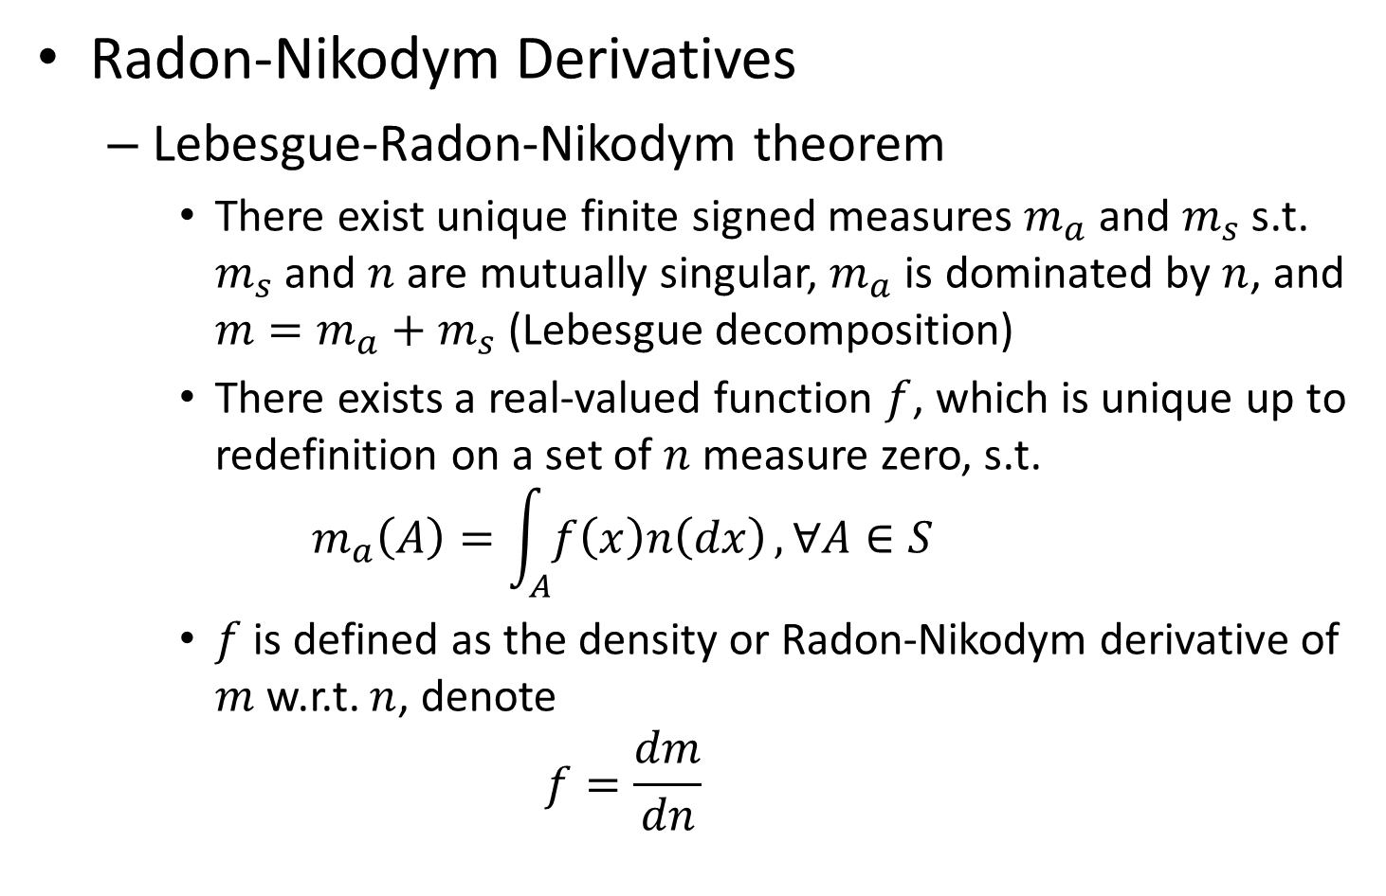
The Metropolis-Hastings-Green Algorithm
Radon-Nikodym Derivatives
Lebesgue-Radon-Nikodym theorem
There exist unique finite signed measures $m_{a}$ and $m_{s}$ s.t. $m_{s}$ and $n$ are mutually singular, $m_{a}$ is dominated by $n$, and $m=m_{a}+m_{s}$ (Lebesgue decomposition)
There exists a real-valued function $f$, which is unique up to redefinition on a set of $n$ measure zero, s.t.
$$m_{a}\left(A\right)=\int_{A}{f\left(x\right)n\left(dx\right)}, ∀A∈S$$
$f$ is defined as the density or Radon-Nikodym derivative of $m$ w.r.t. $n$, denote
$$f=\frac{dm}{dn}$$

Slide 26
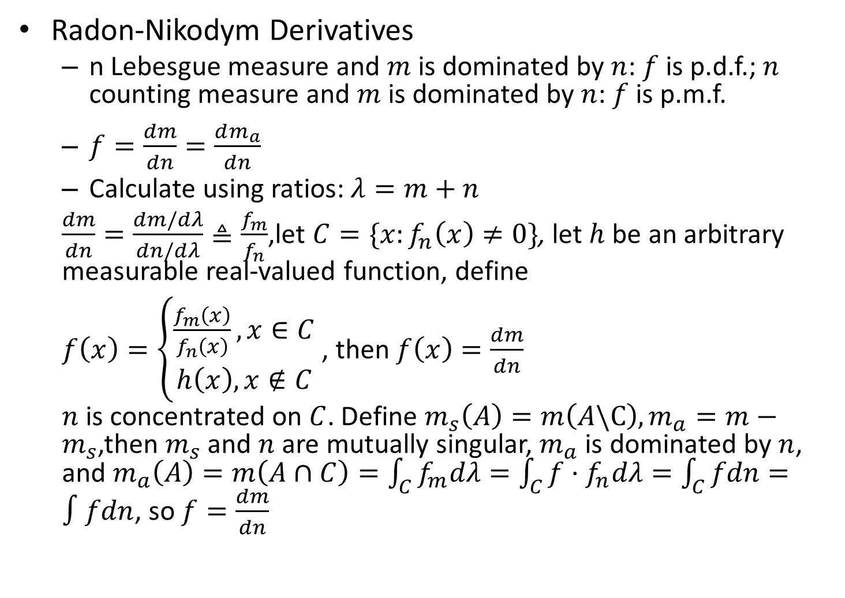
The Metropolis-Hastings-Green Algorithm
Radon-Nikodym Derivatives
n Lebesgue measure and $m$ is dominated by $n$: $f$ is p.d.f.; $n$ counting measure and $m$ is dominated by $n$: $f$ is p.m.f.
$f=\frac{dm}{dn}=\frac{dm_{a}}{dn}$
Calculate using ratios: $λ=m+n$
$\frac{dm}{dn}=\frac{dm/dλ}{dn/dλ}≜\frac{f_{m}}{f_{n}}$,let $C=\{x:f_{n}\left(x\right)≠0\}$, let $h$ be an arbitrary measurable real-valued function, define
$f\left(x\right)=\left\{\begin{aligned}\frac{f_{m}\left(x\right)}{f_{n}\left(x\right)}, x∈C \\ h\left(x\right), x∉C\end{aligned}\right.$ , then $f\left(x\right)=\frac{dm}{dn}$
$n$ is concentrated on $C$. Define $m_{s}\left(A\right)=m\left(A\backslash C\right),m_{a}=m−m_{s}$,then $m_{s}$ and $n$ are mutually singular, $m_{a}$ is dominated by $n$, and $m_{a}\left(A\right)=m\left(A∩C\right)=\int_{C}{f_{m}dλ}=\int_{C}{f⋅f_{n}dλ}=\int_{C}{fdn}=∫fdn$, so $f=\frac{dm}{dn}$

Slide 27
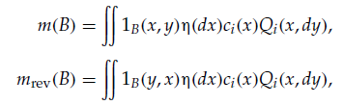
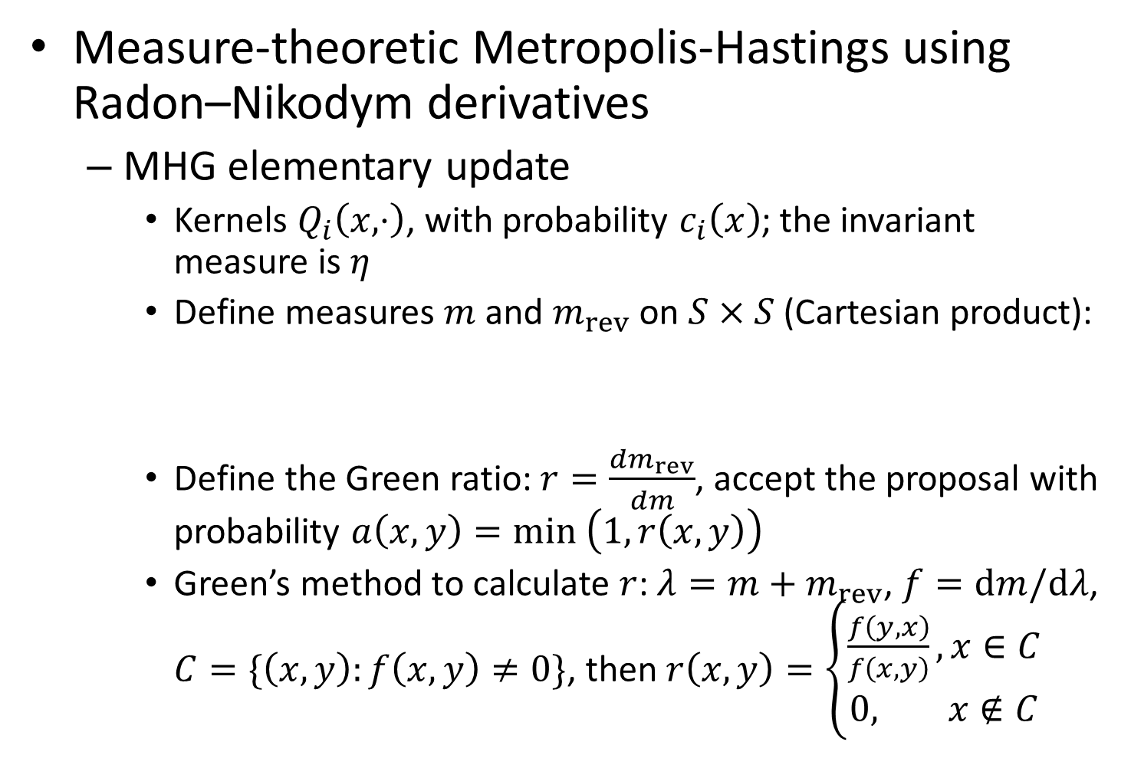
The Metropolis-Hastings-Green Algorithm
Measure-theoretic Metropolis-Hastings using Radon–Nikodym derivatives
MHG elementary update
Kernels $Q_{i}\left(x,⋅\right)$, with probability $c_{i}\left(x\right)$; the invariant measure is $η$
Define measures $m$ and $m_{rev}$ on $S×S$ (Cartesian product):
Define the Green ratio: $r=\frac{dm_{rev}}{dm}$, accept the proposal with probability $a\left(x,y\right)=min \left(1,r\left(x,y\right)\right)$
Green’s method to calculate $r$: $λ=m+m_{rev}$, $f=dm/dλ$, $C=\{\left(x,y\right):f\left(x,y\right)≠0\}$, then $r\left(x,y\right)=\left\{\begin{aligned}\frac{f\left(y,x\right)}{f\left(x,y\right)}, x∈C \\ 0, x∉C\end{aligned}\right.$

Slide 28
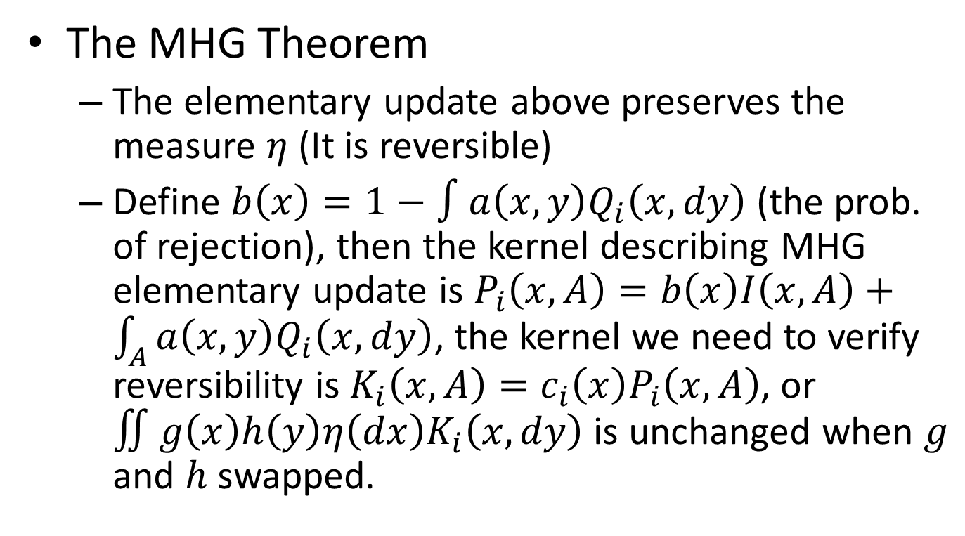
The Metropolis-Hastings-Green Algorithm
The MHG Theorem
The elementary update above preserves the measure $η$ (It is reversible)
Define $b\left(x\right)=1−∫a\left(x,y\right)Q_{i}\left(x,dy\right)$ (the prob. of rejection), then the kernel describing MHG elementary update is $P_{i}\left(x,A\right)=b\left(x\right)I\left(x,A\right)+\int_{A}{a\left(x,y\right)Q_{i}\left(x,dy\right)}$, the kernel we need to verify reversibility is $K_{i}\left(x,A\right)=c_{i}\left(x\right)P_{i}\left(x,A\right)$, or $∬g\left(x\right)h\left(y\right)η\left(dx\right)K_{i}\left(x,dy\right)$ is unchanged when $g$ and $h$ swapped.

Slide 29
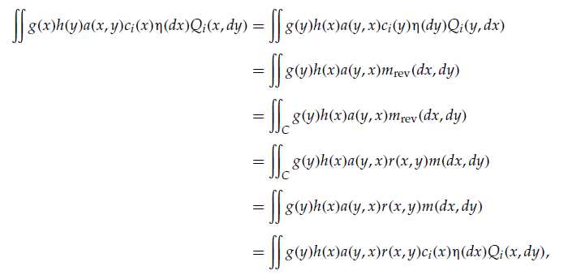
The Metropolis-Hastings-Green Algorithm
The MGH Theorem
We have
so we just need to show that

Slide 30
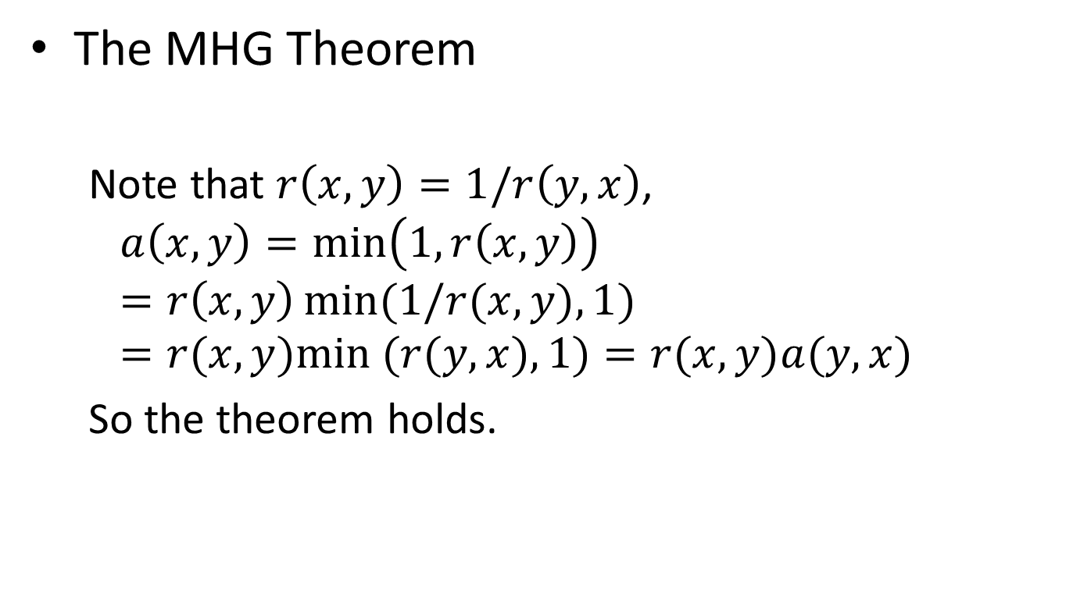
The Metropolis-Hastings-Green Algorithm
The MHG Theorem
Note that $r\left(x,y\right)=1/r\left(y,x\right)$,
$$a\left(x,y\right)=\min\left(1,r\left(x,y\right)\right)=r\left(x,y\right)\min{(1/r(x,y),1)}=r(x,y)min⁡ (r(y,x),1)=r(x,y)a(y,x)$$
So the theorem holds.

Slide 31
The Metropolis-Hastings-Green Algorithm

Slide 32
References
Metropolis, N., Rosenbluth, A. W., Rosenbluth, M. N., Teller, A. H., and Teller, E. 1953. Equation of state calculations by fast computing machines. Journal of Chemical Physics, 21:1087–1092.
Hastings, W. K. 1970. Monte Carlo sampling methods using Markov chains and their applications. Biometrika, 57:97–109.
Geman, S. and Geman, D. 1984. Stochastic relaxation, Gibbs distribution, and the Bayesian restoration of images. IEEE Transactions on Pattern Analysis and Machine Intelligence, 6:721–741.
Green, P. J. 1995. Reversible jump Markov chain Monte Carlo computation and Bayesian model determination. Biometrika, 82:711–732.

Slide 33
MCMC using Hamiltonian dynamics Radford M. Neal
History
Hamiltonian Dynamics
MCMC from Hamiltonian dynamics
HMC in practice and theory
Extensions of and Variations on HMC

Slide 34
MCMC using Hamiltonian Dynamics
History
(Metropolis, et al., 1953) used MCMC to simulate the distribution of molecules. Deterministic approaches using Hamiltonian dynamics doing the same thing was introduced (Alder &Wainwright, 1959).
(Duane, et al., 1987) united the two approaches (hybrid Monte Carlo) . (Neal, 1996a) applied HMC (Hamiltonian Monte Carlo) to neural network models.

Slide 35
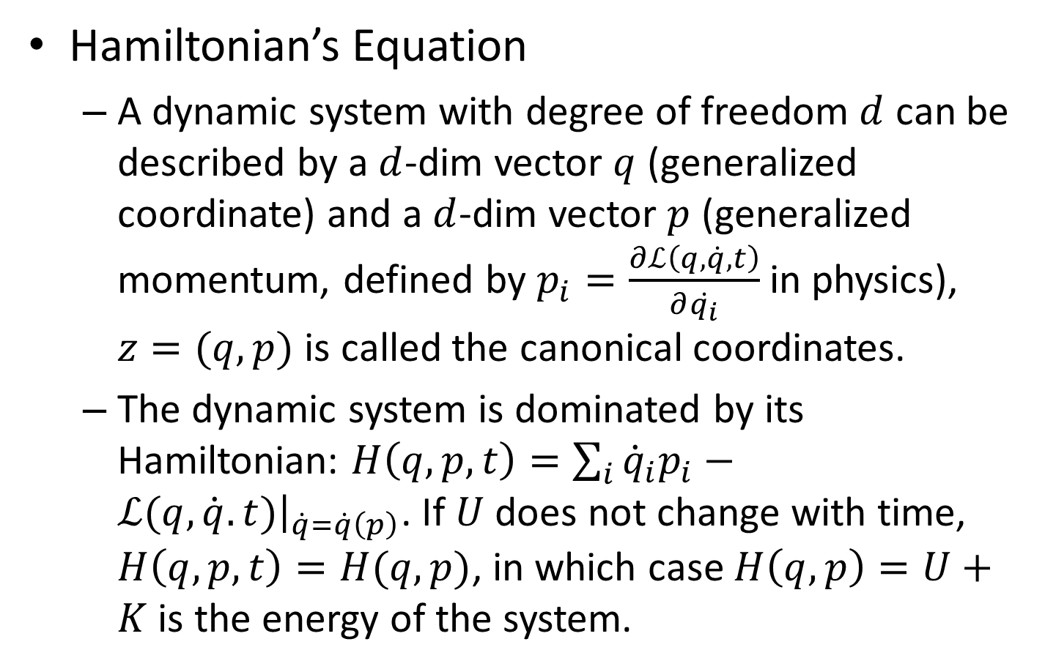
Hamiltonian Dynamics
Hamiltonian’s Equation
A dynamic system with degree of freedom $d$ can be described by a $d$-dim vector $q$ (generalized coordinate) and a $d$-dim vector $p$ (generalized momentum, defined by $p_{i}=\frac{∂ℒ\left(q,\dot{q},t\right)}{∂\dot{q_{i}}}$ in physics), $z=(q,p)$ is called the canonical coordinates.
The dynamic system is dominated by its Hamiltonian: $H\left(q,p,t\right)=\sum_{i}{{\dot{q}}_{i}p_{i}}−ℒ(q,\dot{q}.t){\left.​\right|}_{\dot{q}=\dot{q}\left(p\right)}$. If $U$ does not change with time, $H\left(q,p,t\right)=H(q,p)$, in which case $H\left(q,p\right)=U+K$ is the energy of the system.

Slide 36
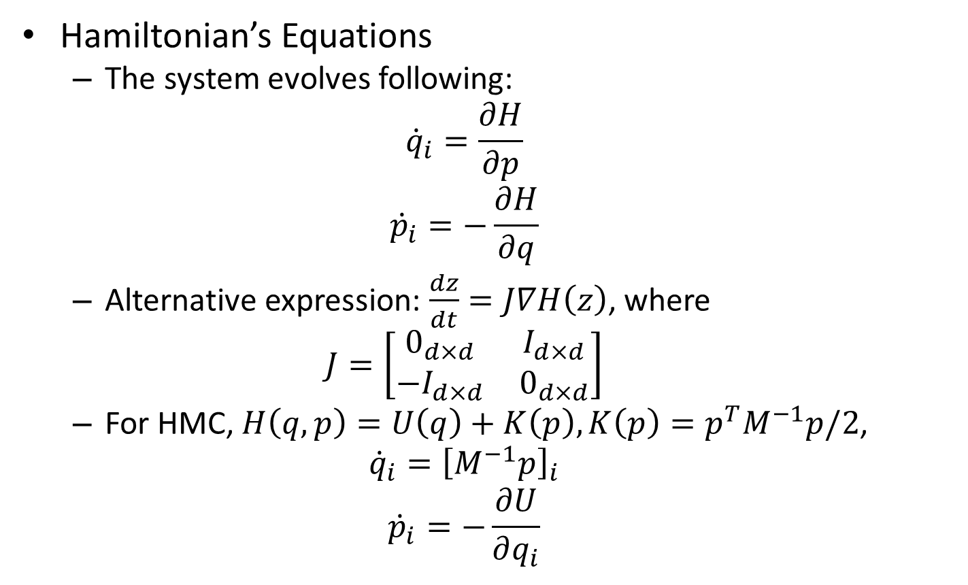
Hamiltonian Dynamics
Hamiltonian’s Equations
The system evolves following:
$${\dot{q}}_{i}=\frac{∂H}{∂p}$$
$${\dot{p}}_{i}=−\frac{∂H}{∂q}$$
Alternative expression: $\frac{dz}{dt}=J∇H\left(z\right)$, where
$$J=\left[\begin{matrix}0_{d×d} & I_{d×d} \\ −I_{d×d} & 0_{d×d}\end{matrix}\right]$$
For HMC, $H\left(q,p\right)=U\left(q\right)+K\left(p\right),K\left(p\right)=p^{T}M^{−1}p/2$,
$${\dot{q}}_{i}={\left[M^{−1}p\right]}_{i}$$
$${\dot{p}}_{i}=−\frac{∂U}{∂q_{i}}$$

Slide 37

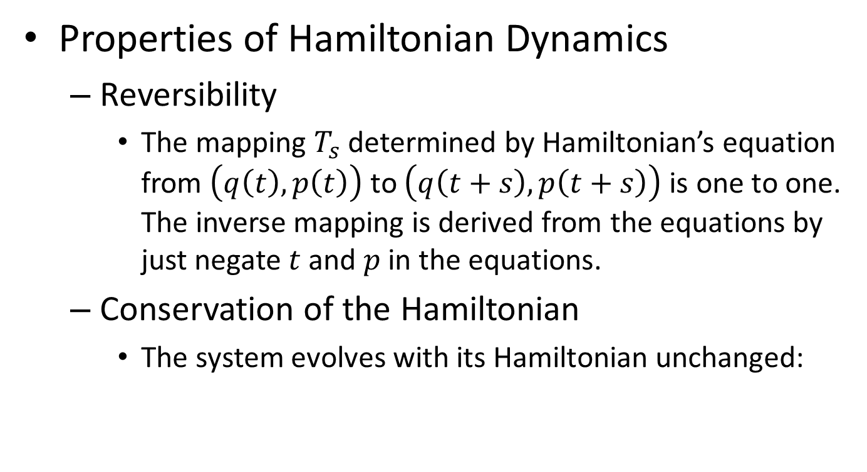
Hamiltonian Dynamics
Properties of Hamiltonian Dynamics
Reversibility
The mapping $T_{s}$ determined by Hamiltonian’s equation from $\left(q\left(t\right),p\left(t\right)\right)$ to $\left(q\left(t+s\right),p\left(t+s\right)\right)$ is one to one. The inverse mapping is derived from the equations by just negate $t$ and $p$ in the equations.
Conservation of the Hamiltonian
The system evolves with its Hamiltonian unchanged:

Slide 38
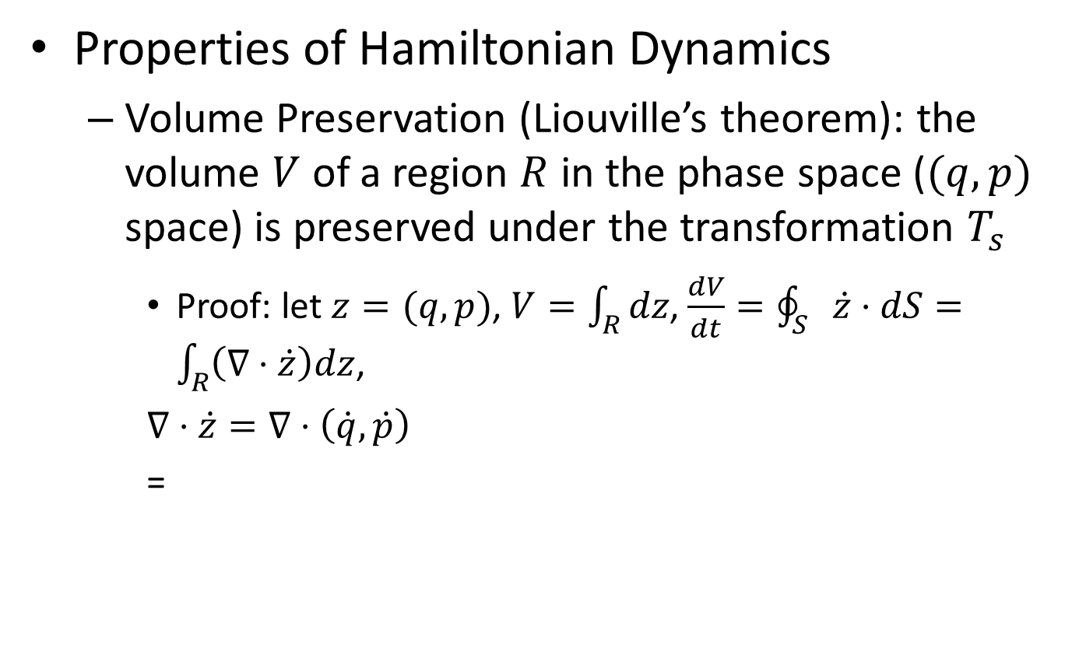
Hamiltonian Dynamics
Properties of Hamiltonian Dynamics
Volume Preservation (Liouville’s theorem): the volume $V$ of a region $R$ in the phase space ($(q,p)$ space) is preserved under the transformation $T_{s}$
Proof: let $z=(q,p)$, $V=\int_{R}{dz}$, $\frac{dV}{dt}=\oint_{S}{\dot{z}⋅dS}=\int_{R}{\left(∇⋅\dot{z}\right)dz}$,
$∇⋅\dot{z}=∇⋅\left(\dot{q},\dot{p}\right)$
=

Slide 39
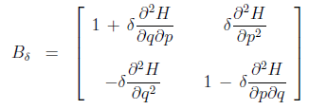

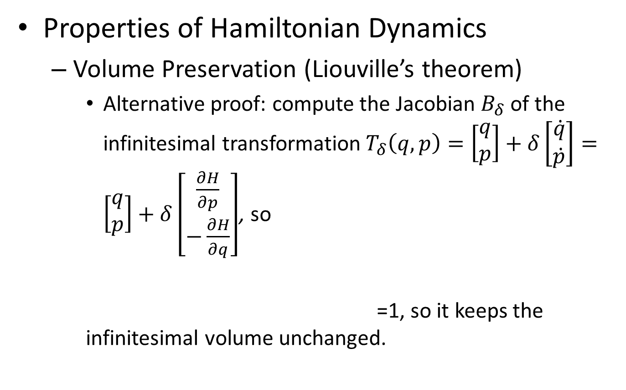
Hamiltonian Dynamics
Properties of Hamiltonian Dynamics
Volume Preservation (Liouville’s theorem)
Alternative proof: compute the Jacobian $B_{δ}$ of the infinitesimal transformation $T_{δ}\left(q,p\right)=\left[\begin{aligned}q \\ p\end{aligned}\right]+δ\left[\begin{aligned}\dot{q} \\ \dot{p}\end{aligned}\right]=\left[\begin{aligned}q \\ p\end{aligned}\right]+δ\left[\begin{aligned}\frac{∂H}{∂p} \\ −\frac{∂H}{∂q}\end{aligned}\right]$, so
=1, so it keeps the infinitesimal volume unchanged.

Slide 40
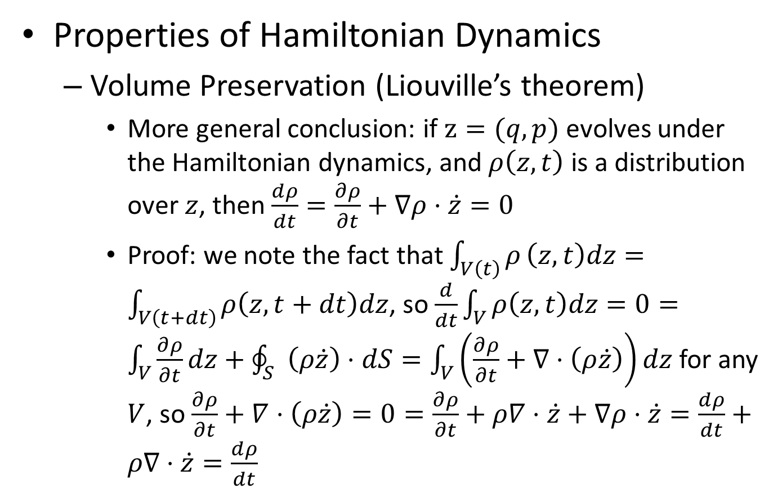
Hamiltonian Dynamics
Properties of Hamiltonian Dynamics
Volume Preservation (Liouville’s theorem)
More general conclusion: if $z=(q,p)$ evolves under the Hamiltonian dynamics, and $ρ\left(z,t\right)$ is a distribution over $z$, then $\frac{dρ}{dt}=\frac{∂ρ}{∂t}+∇ρ⋅\dot{z}=0$
Proof: we note the fact that $\int_{V\left(t\right)}{ρ}\left(z,t\right)dz=\int_{V\left(t+dt\right)}{ρ\left(z,t+dt\right)dz}$, so $\frac{d}{dt}\int_{V}{ρ\left(z,t\right)dz}=0=\int_{V}{\frac{∂ρ}{∂t}}dz+\oint_{S}{\left(ρ\dot{z}\right)⋅dS}=\int_{V}{\left(\frac{∂ρ}{∂t}+∇⋅\left(ρ\dot{z}\right)\right)dz}$ for any $V$, so $\frac{∂ρ}{∂t}+∇⋅\left(ρ\dot{z}\right)=0=\frac{∂ρ}{∂t}+ρ∇⋅\dot{z}+∇ρ⋅\dot{z}=\frac{dρ}{dt}+ρ∇⋅\dot{z}=\frac{dρ}{dt}$

Slide 41
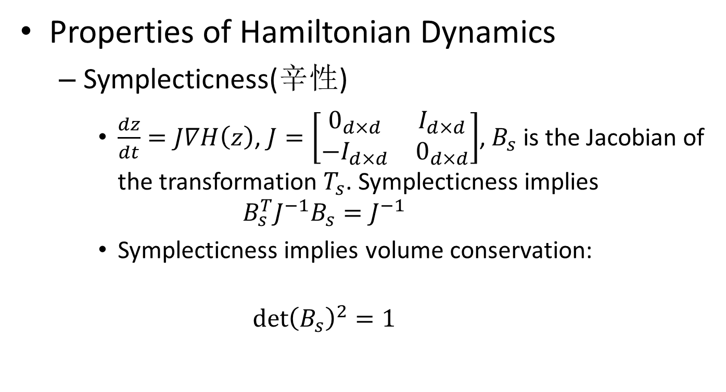
Hamiltonian Dynamics
Properties of Hamiltonian Dynamics
Symplecticness(辛性)
$\frac{dz}{dt}=J∇H\left(z\right)$, $J=\left[\begin{matrix}0_{d×d} & I_{d×d} \\ −I_{d×d} & 0_{d×d}\end{matrix}\right]$, $B_{s}$ is the Jacobian of the transformation $T_{s}$. Symplecticness implies
$$B_{s}^{T}J^{−1}B_{s}=J^{−1}$$
Symplecticness implies volume conservation:
$${\det\left(B_{s}\right)}^{2}=1$$

Slide 42
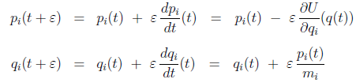
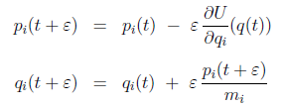
Hamiltonian Dynamics
Discretized methods for computing Hamiltonian evolution
Euler’s method
Cannot preserve volume
Modified Euler’s method
Volume conversation is guaranteed. (“Shear” transformation)

Slide 43
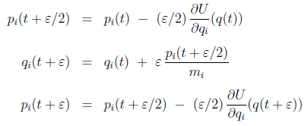
Hamiltonian Dynamics
Discretized methods for computing Hamiltonian evolution
The leapfrog method
Preserves volume (each is a “shear” transformation)

Slide 44
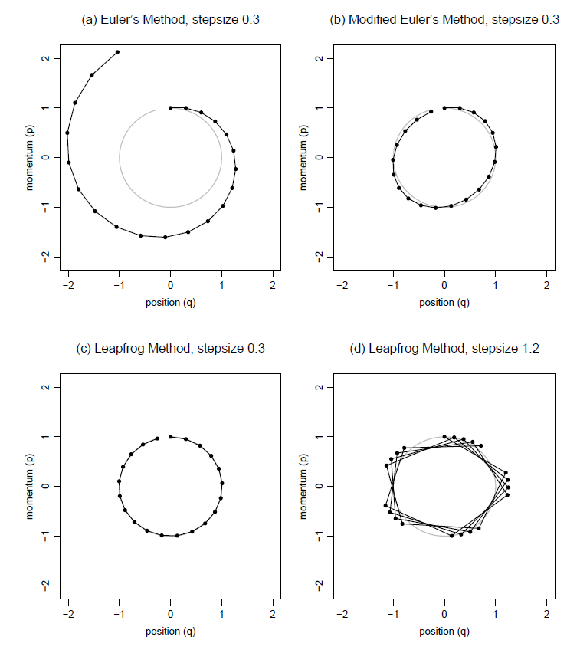
Hamiltonian Dynamics
Discretized methods for computing Hamiltonian evolution

Slide 45
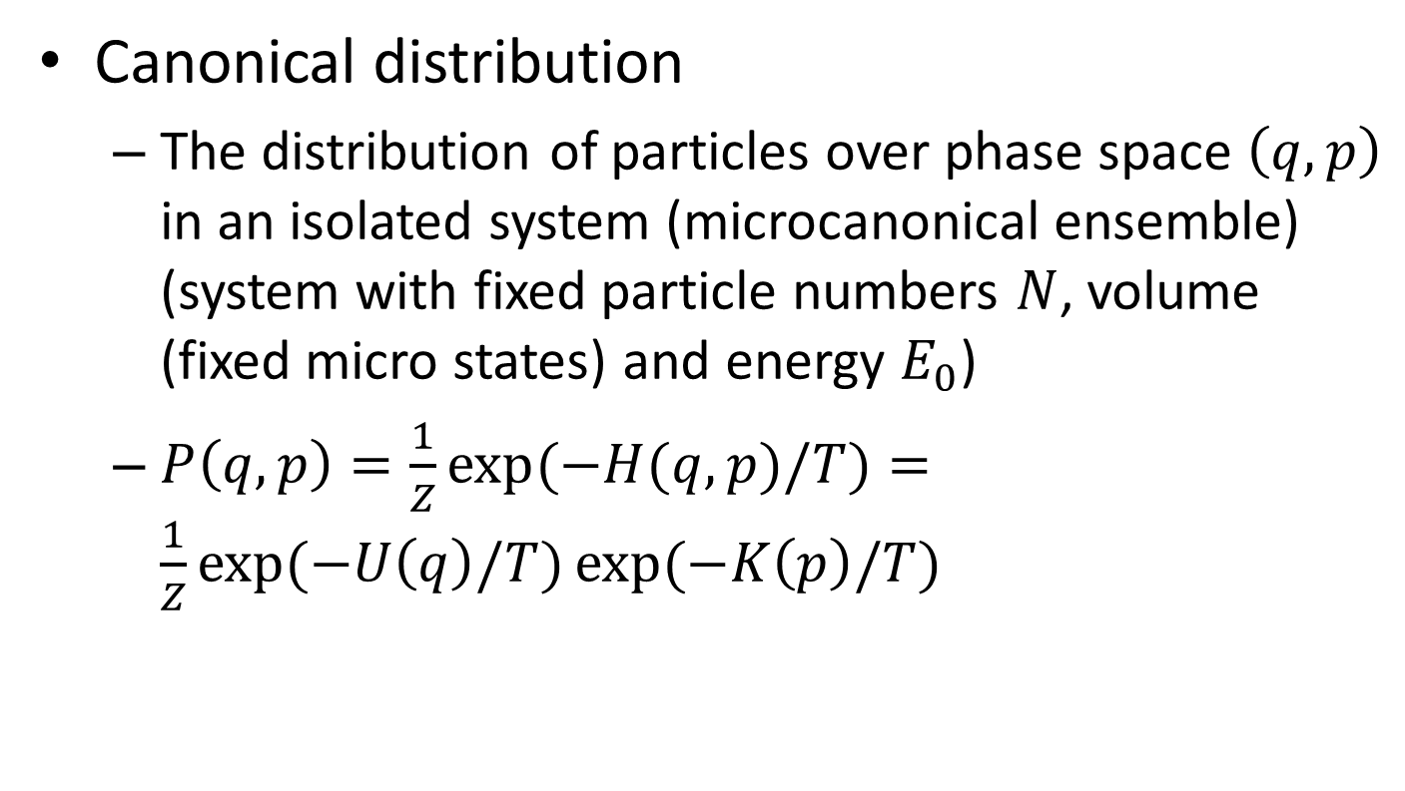
MCMC from Hamiltonian dynamics
Canonical distribution
The distribution of particles over phase space $\left(q,p\right)$ in an isolated system (microcanonical ensemble) (system with fixed particle numbers $N$, volume (fixed micro states) and energy $E_{0}$)
$P\left(q,p\right)=\frac{1}{Z}\exp{(−H(q,p)/T)}=\frac{1}{Z}\exp{(−U\left(q\right)/T)}\exp{(−K\left(p\right)/T)}$

Slide 46
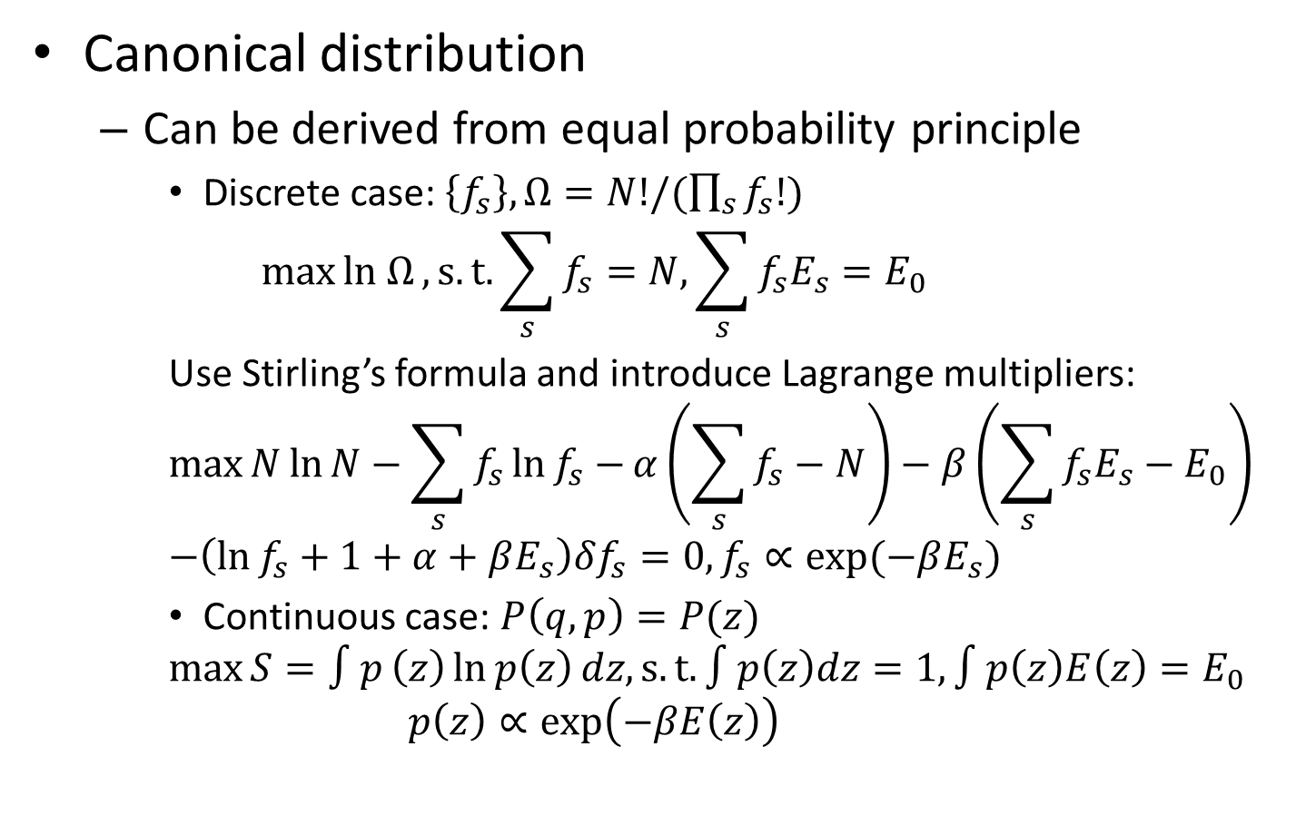
MCMC from Hamiltonian dynamics
Canonical distribution
Can be derived from equal probability principle
Discrete case: $\left\{f_{s}\right\}, Ω=N!/(\prod_{s}{f_{s}!})$
$$\max{ln Ω},s.t. \sum_{s}{f_{s}}=N,\sum_{s}{f_{s}E_{s}}=E_{0}$$
Use Stirling’s formula and introduce Lagrange multipliers:
$$\max{N\ln{N}−\sum_{s}{f_{s}\ln{f_{s}}}−}α\left(\sum_{s}{f_{s}}−N\right)−β\left(\sum_{s}{f_{s}E_{s}}−E_{0}\right) \\ −\left(\ln{f_{s}}+1+α+βE_{s}\right)δf_{s}=0, f_{s}∝\exp{(−βE_{s})}$$
Continuous case: $P\left(q,p\right)=P(z)$
$$\max{S=∫p}\left(z\right)\ln{p\left(z\right)}dz, s.t. ∫p\left(z\right)dz=1, ∫p\left(z\right)E\left(z\right)=E_{0}$$
$$p\left(z\right)∝\exp\left(−βE\left(z\right)\right)$$

Slide 47
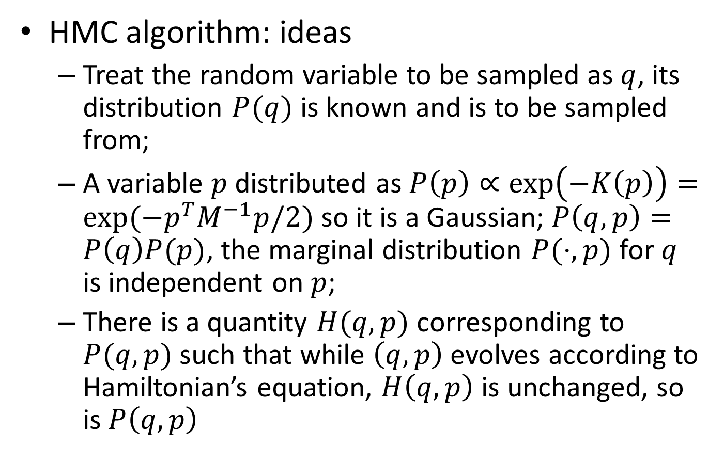
MCMC from Hamiltonian dynamics
HMC algorithm: ideas
Treat the random variable to be sampled as $q$, its distribution $P(q)$ is known and is to be sampled from;
A variable $p$ distributed as $P\left(p\right)∝\exp\left(−K\left(p\right)\right)=\exp{(−p^{T}M^{−1}p/2)}$ so it is a Gaussian; $P\left(q,p\right)=P\left(q\right)P(p)$, the marginal distribution $P(⋅,p)$ for $q$ is independent on $p$;
There is a quantity $H(q,p)$ corresponding to $P(q,p)$ such that while $\left(q,p\right)$ evolves according to Hamiltonian’s equation, $H\left(q,p\right)$ is unchanged, so is $P\left(q,p\right)$

Slide 48
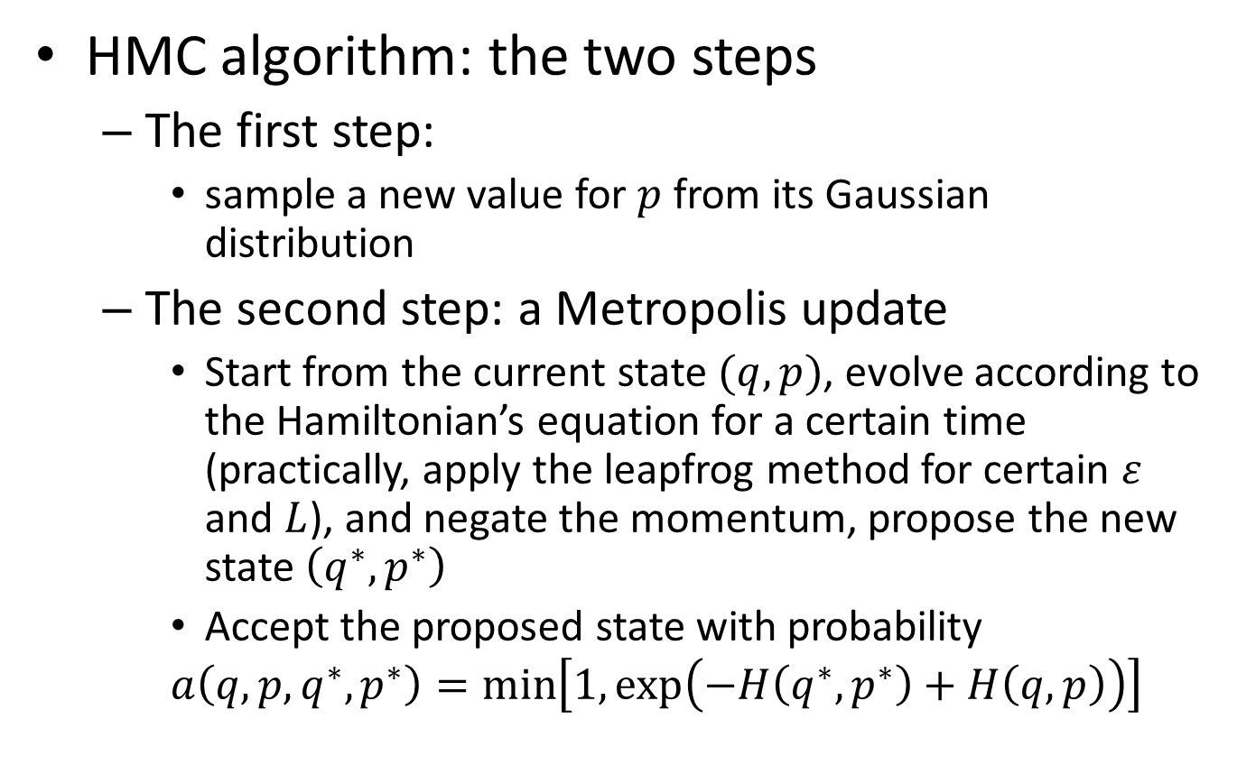
MCMC from Hamiltonian dynamics
HMC algorithm: the two steps
The first step:
sample a new value for $p$ from its Gaussian distribution
The second step: a Metropolis update
Start from the current state $(q,p)$, evolve according to the Hamiltonian’s equation for a certain time (practically, apply the leapfrog method for certain $ε$ and $L$), and negate the momentum, propose the new state $\left(q^{∗},p^{∗}\right)$
Accept the proposed state with probability
$$a\left(q,p,q^{∗},p^{∗}\right)=\min\left[1,\exp\left(−H\left(q^{∗},p^{∗}\right)+H\left(q,p\right)\right)\right]$$

Slide 49
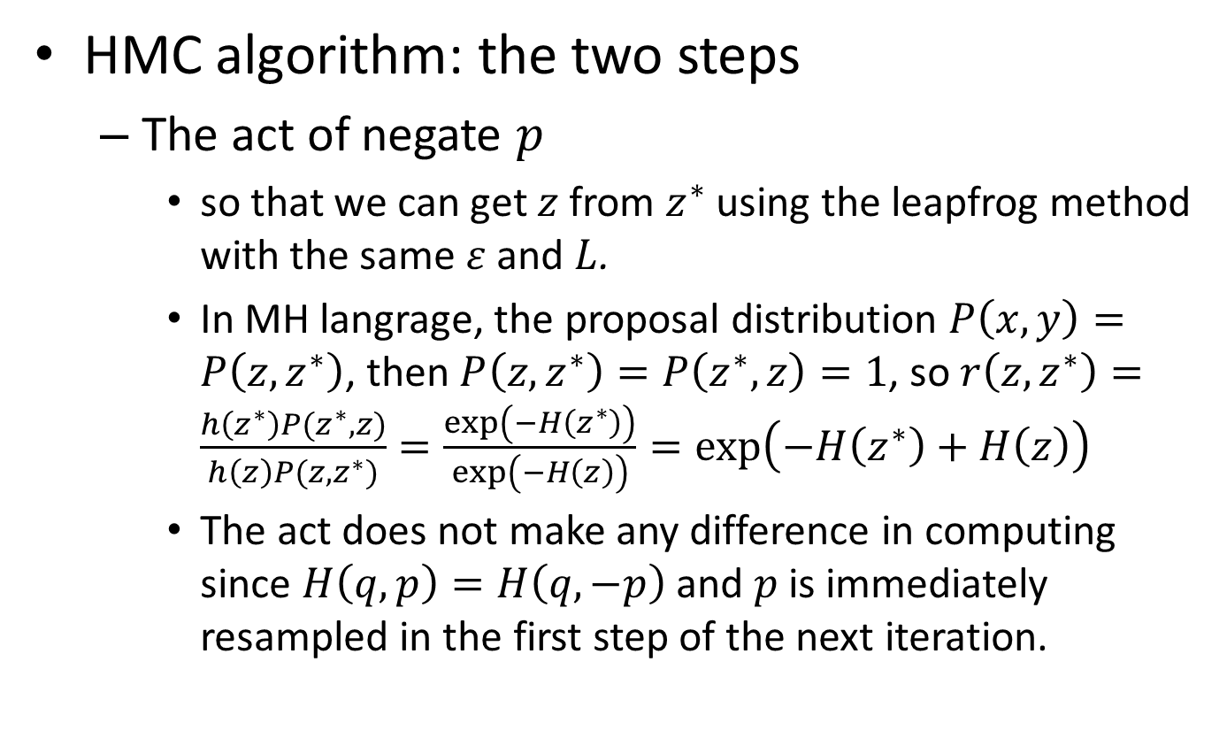
MCMC from Hamiltonian dynamics
HMC algorithm: the two steps
The act of negate $p$
so that we can get $z$ from $z^{∗}$ using the leapfrog method with the same $ε$ and $L$.
In MH langrage, the proposal distribution $P\left(x,y\right)=P\left(z,z^{∗}\right)$, then $P\left(z,z^{∗}\right)=P\left(z^{∗},z\right)=1$, so $r\left(z,z^{∗}\right)=\frac{h\left(z^{∗}\right)P(z^{∗},z)}{h\left(z\right)P(z,z^{∗})}=\frac{\exp\left(−H\left(z^{∗}\right)\right)}{\exp\left(−H\left(z\right)\right)}=\exp\left(−H\left(z^{∗}\right)+H\left(z\right)\right)$
The act does not make any difference in computing since $H\left(q,p\right)=H\left(q,−p\right)$ and $p$ is immediately resampled in the first step of the next iteration.

Slide 50
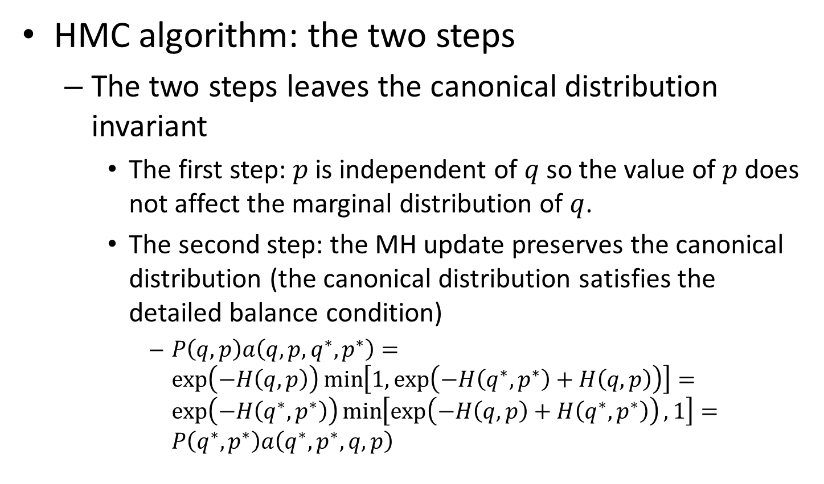
MCMC from Hamiltonian dynamics
HMC algorithm: the two steps
The two steps leaves the canonical distribution invariant
The first step: $p$ is independent of $q$ so the value of $p$ does not affect the marginal distribution of $q$.
The second step: the MH update preserves the canonical distribution (the canonical distribution satisfies the detailed balance condition)
$P\left(q,p\right)a\left(q,p,q^{∗},p^{∗}\right)=\exp\left(−H\left(q,p\right)\right)\min\left[1,\exp\left(−H\left(q^{∗},p^{∗}\right)+H\left(q,p\right)\right)\right]=\exp\left(−H\left(q^{∗},p^{∗}\right)\right)\min\left[\exp\left(−H\left(q,p\right)+H\left(q^{∗},p^{∗}\right)\right),1\right]=P\left(q^{∗},p^{∗}\right)a\left(q^{∗},p^{∗},q,p\right)$

Slide 51
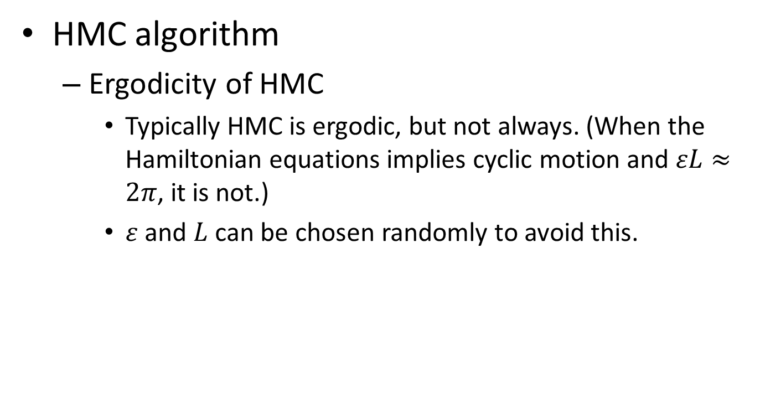
MCMC from Hamiltonian dynamics
HMC algorithm
Ergodicity of HMC
Typically HMC is ergodic, but not always. (When the Hamiltonian equations implies cyclic motion and $εL≈2π$, it is not.)
$ε$ and $L$ can be chosen randomly to avoid this.

Slide 52

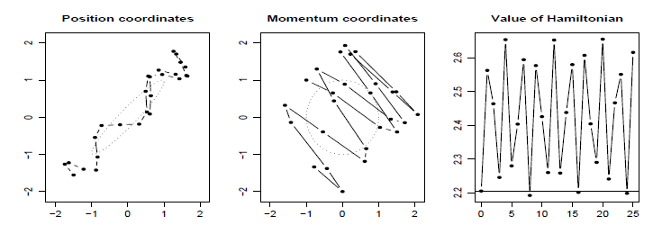

MCMC from Hamiltonian dynamics
Illustrations of HMC and its benefits
Trajectories for a 2-d problem
Sampling from a bivariate Gaussian with zero means
Trajectory different from RW, along the valley; $ε$ affects the oscillation of the Hamiltonian: larger values may cause instability; smaller values may keep the oscillation bounded for arbitrarily large $L$
Notes:
Diff from random walk; travel along the axis

Slide 53

MCMC from Hamiltonian dynamics
Illustrations of HMC and its benefits
Sample from a 2-d distribution
20 iterates each with 20 updates
Rejection rate: 0.37 vs. 0.09 (parameter s.t. comparable change in state for every iteration)

Slide 54

MCMC from Hamiltonian dynamics
Illustrations of HMC and its benefits
Sample from a 2-d distribution
200 trajectories of the first coordinate

Slide 55

MCMC from Hamiltonian dynamics
Illustrations of HMC and its benefits
The benefits of avoiding random walk
Both the proposal sd of RW Metropolis and $ε$ of HMC are required to be less than the sd in the most constrained direction;
The sd of the amount moved is $\sqrt{n}$ for RW Metropolis, and $n$ for HMC, since HMC can move consistently in one direction.
Larger sd implies less autocorrelation, thus more efficient.

Slide 56

MCMC from Hamiltonian dynamics
Illustrations of HMC and its benefits
Sampling from a 100-d distribution
100-d multivariate Gaussian where $Σ=diag({0.01}^{2},{0.02}^{2},…,{0.99}^{2},{1.00}^{2})$
Use HMC:
$ε$ should on the order of the least sd to ensure stability of the Hamiltonian
$H\left(q,p\right)=\frac{1}{2}p^{T}p+\frac{1}{2}q^{T}Σ^{−1}q$, the solution from the Hamiltonian’s equation is $q_{i}\left(t\right)=A\sin\left(\frac{t}{\sqrt{Σ_{i}}}+φ\right)$. If we choose $ε=0.013,L=150$, when $\sqrt{Σ_{31}}=0.31$ or $\sqrt{Σ_{62}}=0.62$, we have $\frac{εL}{\sqrt{Σ_{i}}}=6.29≈2π$ or $3.14≈π$, which would break ergodicity.
So we can choose $ε$ randomly from $0.013±20\%$ uniformly.

Slide 57

MCMC from Hamiltonian dynamics
Illustrations of HMC and its benefits
Sampling from a 100-d distribution

Slide 58

MCMC from Hamiltonian dynamics
Illustrations of HMC and its benefits
Sampling from a 100-d distribution

Slide 59

HMC in Practice and Theory
Effect of Linear Transformations
The new variable $q^{′}=Aq$, where $A$ is nonsingular. Then we can sample $q′$ from its distribution $P^{′}\left(q^{′}\right)=P(A^{−1}q′)/\left|\det\left(A\right)\right|$ using HMC with $p^{′}={\left(A^{T}\right)}^{−1}p$, $M^{′}={\left(A^{−1}\right)}^{T}MA^{−1}$
When $A$ is orthogonal and $M=mI$, then $p^{′}=p$, $M^{′}=mI=M$
In case where the estimate of the covariance matrix $Σ$ of $q$ is known and $q$ has roughly Gaussian distribution, we let $q^{′}=L^{−1}q$, where $Σ=LL^{T}$, then components of $q′$ tend to be independent, and the Hamiltonian $H\left(q^{′},p\right)=q^{′T}q^{′}/2+p^{T}p/2$
An equivalent way: use $K\left(p\right)=p^{T}Σp/2$

Slide 60




HMC in Practice and Theory
Tuning HMC
Preliminary runs for leapfrog with different $ε$ and $L$ and different start positions. Observe the trace plot.
Choose the step size $ε$
A 1-d example: $H\left(q,p\right)=\frac{q^{2}}{2σ^{2}}+\frac{p^{2}}{2}$,
The eigenvalues of the matrix:
When $\frac{ε}{σ}>2$, one of the eigenvalues (both real) >1, so the error will grow exponentially w.r.t. $L$; when $\frac{ε}{σ}<2$, both eigenvalues are complex with magnitude
so it is stable.

Slide 61

HMC in Practice and Theory
Tuning HMC
Choose the step size $ε$
So the consequence of large $ε$ is severe. Often chosen less than the smallest sd of $q$ components. In case of different largest $ε$ in different points, choose $ε$ randomly.
Choose the trajectory length $L$
$L$ is desired to be large to avoid RW behavior, but too large $L$ may cause the reverse of trajectory and a near proposal

Slide 62


HMC in Practice and Theory
Tuning HMC
Using multiple stepsizes
In case where we know the SDs of every component of $q$
Often more convenient than above two methods

Slide 63

HMC in Practice and Theory
Scaling with dimensionality
HMC is more scalable to dimensionality than RW Metropolis in sample equilibrium time
Consider the case where the high-dim data are independent, or by replication $q=(q_{1},…,q_{d})$
Denote $Δ=E\left(x^{∗}\right)−E\left(x\right),$ and $Δ_{1}$ for one component and $Δ_{d}$ for $q$, $Δ_{d}∼dΔ_{1}.$ The acceptance rate $\min{(1,\exp{(−Δ_{d})})}$ will decrease for both methods.

Slide 64

HMC in Practice and Theory
Scaling with dimensionality
Compare the scalability of the two methods in sample equilibrium time to dimensionality under the requisition for stable acceptance rate:
RW Metropolis (with $ζ$ being the SD of the proposal)
$x^{∗}=x+c$ and $c=±a$ equally likely; $U\left(x^{∗}\right)∼U\left(x\right)+cU^{′}\left(x\right)+c^{2}U^{′′}\left(x\right)/2$, so $Δ_{1}∼a^{2}U^{′′}\left(x\right)$, $E\left[Δ_{d}\right]∼dE\left[Δ_{1}\right]∼ζ^{2}⇒ζ∼d^{1/2}$. The number of iterations $n∼ζ^{−2}∼d$ (since $\sqrt{n}ζ∼1$), so $t∼d^{2}$

Slide 65

HMC in Practice and Theory
Scaling with dimensionality
Compare the scalability of the two methods in sample equilibrium time to dimensionality under the requisition for stable acceptance rate:
HMC (with $ε$ begin the step size)
Creutz (1988, Section III) notes
So $\exp{(−Δ_{1})}∼1−Δ_{1}+\frac{Δ_{1}^{2}}{2}=1,E\left[Δ_{1}\right]∼E[Δ_{1}^{2}]/2$
$Δ_{1}∼ε^{2},E\left[Δ_{1}\right]∼E\left[Δ_{1}^{2}\right]∼ε^{4}$. $Δ_{d}∼dε^{4}⇒ε∼d^{−1/4}$. $n∼1/ε$ (since $nε∼1$), so $t∼d^{5/4}$.

Slide 66




Extensions of and Variations on HMC
The Langevin Method
One leapfrog step in each iteration
If neglecting $p$, $q_{i}^{∗}$ is sampled from $𝒩\left(q_{i}−\left(\frac{ε^{2}}{2}\right)\left(\frac{∂U\left(q\right)}{∂q_{i}}\right),ε^{2}\right)$, acceptance probability

Slide 67

Extensions of and Variations on HMC
The Langevin Method
Small change in each iteration, so behaves as RW
Scalability to dimensionality
$E\left[Δ_{1}\right]∼E\left[Δ_{1}^{2}\right]∼ε^{6}$, $E\left[Δ_{d}\right]∼dE\left[Δ_{1}\right]⇒ε∼d^{−1/6}$. $t∼d⋅ε^{−2}∼d^{4/3}$, better than RW Metropolis, worse than HMC

Slide 68
References
Metropolis, N., Rosenbluth, A. W., Rosenbluth, M. N., Teller, A. H., and Teller, E. (1953). Equation of state calculations by fast computing machines. Journal of Chemical Physics, 21:1087–1092.
Alder, B. J. andWainwright, T. E. (1959). Studies in molecular dynamics. I. General method. Journal of Chemical Physics, 31:459–466.
Duane, S., Kennedy, A. D., Pendleton, B. J., and Roweth, D. (1987). Hybrid Monte Carlo. Physics Letters B, 195:216–222.
Neal, R. M. (1996a). Bayesian Learning for Neural Networks. Lecture Notes in Statistics, No. 118. Springer-Verlag.
Creutz, M. 1988. Global Monte Carlo algorithms for many-fermion systems. Physical Review D, 38:1228–1238.

Slide 69
Thanks!

